Slide 1

Notes:
Welcome to our ASEA presentation. What is ASEA? ASEA is a Cellular Health Company

Slide 2
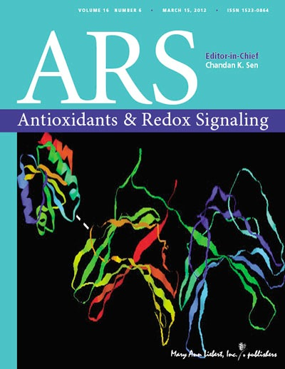
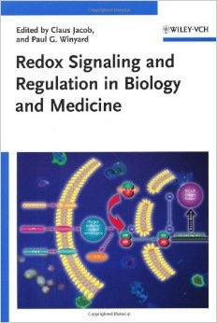

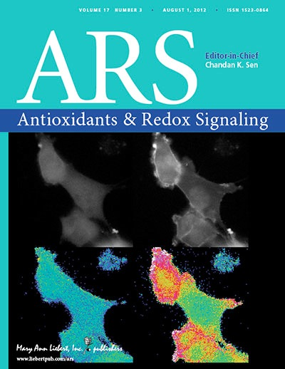
La biochimie Redox : un des domaines de la science à plus forte croissance au monde!
Plus de 8000 études sur la signalisation Redox ont été publiées dans des revues scientifiques et médicales révisées par les pairs.
Notes:
ASEA’s products use a technology that is based on a new area of science called “Redox Biochemistry” . Even though you may not have heard of redox biochemistry before now, it is one of the fastest growing areas of science in the world. Numerous mainstream medical journals are devoted to the study of redox biochemistry .. Thousands of studies on redox signaling have been published in peer reviewed scientific and medical journals

Slide 3
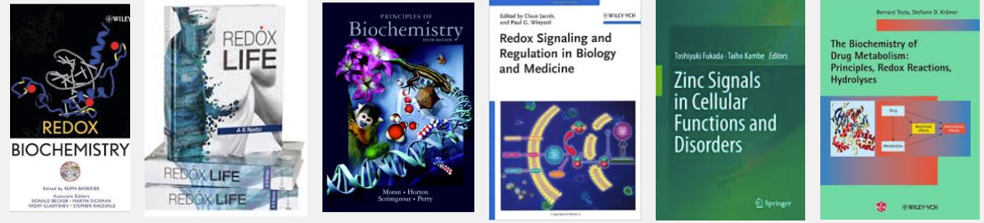
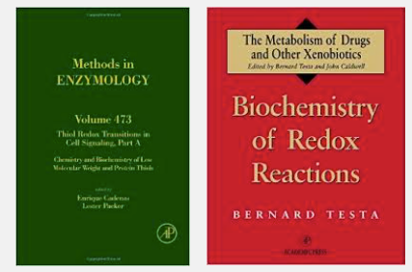
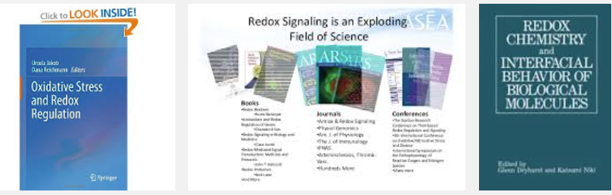
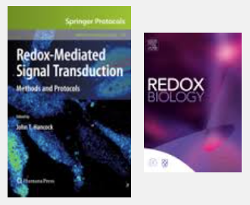
La biochimie Redox : un des domaines de la science à plus forte croissance au monde!
Il existe plus de 1200 livres sur la signalisation Redox.
Notes:
Over 1200 books on Redox BioChemistry have been published.

Slide 4
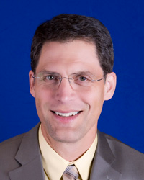

Robertson D. Ward, M.D. FAAFP
Système endocrinien
Système cardiovasculaire
Système immunitaire
Système locomoteur
Épiderme
Notes:
a website called the redox doc .com explains how redox molecules affect the various systems of the body

Slide 5
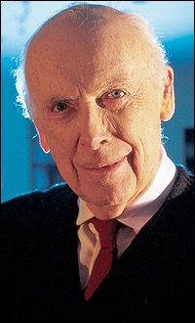
L'article de James Watson dans le Lancet fait connaître la technologie REDOX et renforce sa crédibilité
Lancet, mars 2014
Suggère que plusieurs maladies graves découlent d'une carence en molécules de signalisation Redox
Selon lui, le diabète de type 2 serait une maladie liée aux molécules Redox
Lauréat du prix Nobel en sciences pour avoir co-découvert le double hélice d'ADN
Notes:
An article written by James Lancet, a Nobel award winner, was recently published in one of the most prestigious medical journals in the world, called the Lancet. In this article, James Lancet suggested

Slide 6
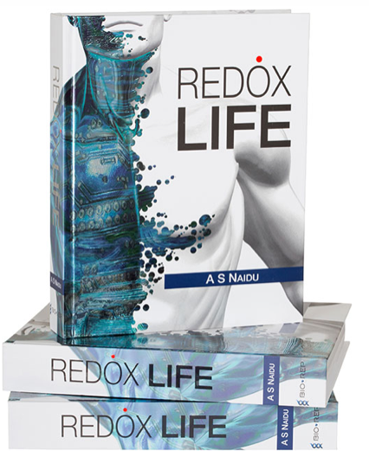

Qu'est-ce que les molécules Redox?
La cellule
Les molécules de signalisation Redox contribuent à presque chaque fonction et système du corps.
(eau salée)
Mitochondrie
(centrale)
Énergie ATP
Molécules de signalisation Redox
Les molécules de signalisation Redox sont essentielles à la santé et à la guérison des cellules.
Notes:
Several years ago scientist learned about the redox discovery. Here is what it is: our cells are made of salt and water. Inside of the cell is a power plant called the mitochondria that produces energy. (that’s why we’re alive. all of our cells are always producing energy.)
In the process of producing energy, the mitochondria also produces Redox Signalling Molecules using only salt and water . These very important Redox Molecules control virtually every major body system and function: the immune system, the endocrine system, the nervous system, the digestive system, etc. These molecules are foundational to the health of every one of our 75 trillion cells.

Slide 7
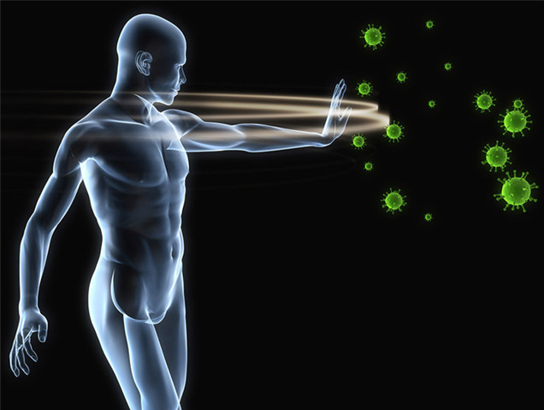
La meilleure défense contre la maladie et le vieillissement? Des cellules en santé!
Elles nous permettent de vivre LONGTEMPS, en SANTÉ et à rester JEUNES!
© 2012
Notes:
Redox molecules allow our cells to repair and replace themselves . They are our best defense against disease and aging . they help us live longer , healthier and younger! Who would like to live longer, healthier , and younger? (everyone raises their hands.)

Slide 8


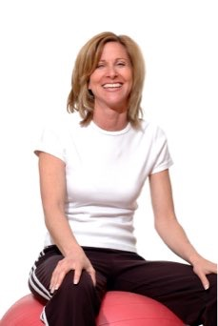
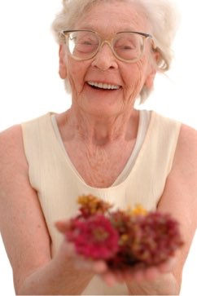
Le vieillissement, une alimentation imparfaite et le stress diminuent la production de molécules Redox
Carences et déséquilibres
Notes:
Please raise your hand if you are getting older every day! (everyone laughs and raises their hand). Ok, Because we are all getting older every day, and because of poor diet and stress like I mentioned on the previous slide, as we age, our body makes less and less of these very important redox molecules. A brand new healthy baby makes lot of redox molecules. Little children typically have alot of energy and they heal very quickly. The fall out of trees, skin their knees ,and just get up and start running around again. But as we age, year by year, we produce less and less redox molecules. That is why as we get older, we get more tired, we have less energy, we get wrinkles, our hair turns grey, we don’t see as well, we don’t heal as quickly.

Slide 9
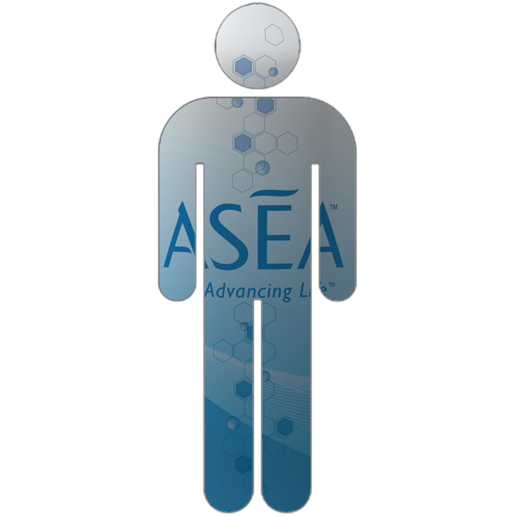
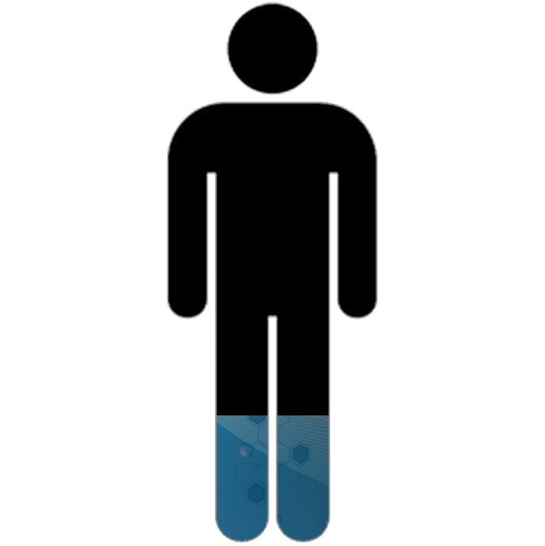
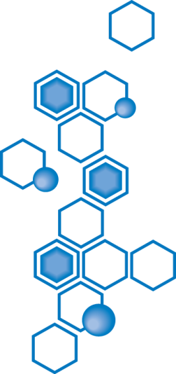
Notes:
So , this is what our bodies look like, depleted in their supply of redox molecules. But what if there was a way to replenish these signaling molecules that are made inside of our cells so that we could look and feel the way we did 5-10-15 -20 years ago??

Slide 10
Notes:
Welcome to our ASEA presentation. What is ASEA? ASEA is a Cellular Health Company

Slide 11

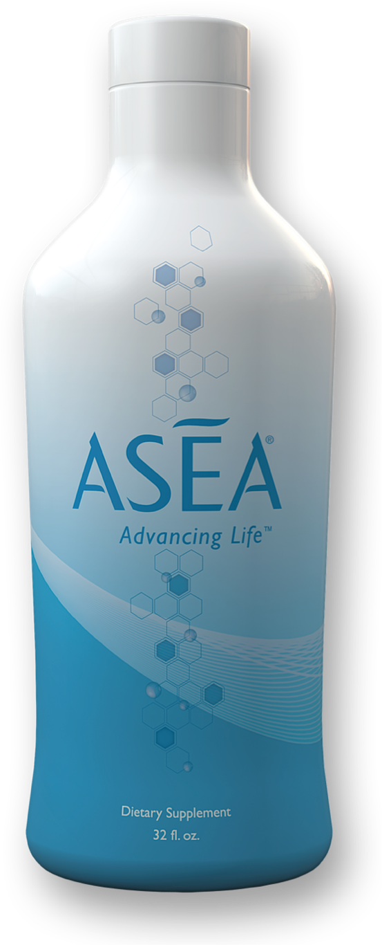
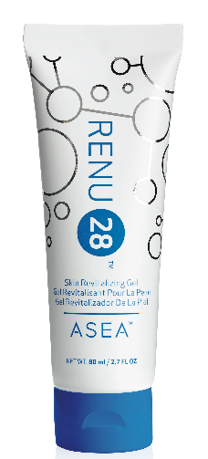
Mettez à profit le pouvoir des molécules Redox
Notes:
So, for the first time in history, Verdis and Gary were able to harness the power of these important Redox Signalling Molecules. They turned down a huge offer from a pharmaceutical company to purchase these molecules because they believe that people around the world deserve to benefit from the molecules.

Slide 12
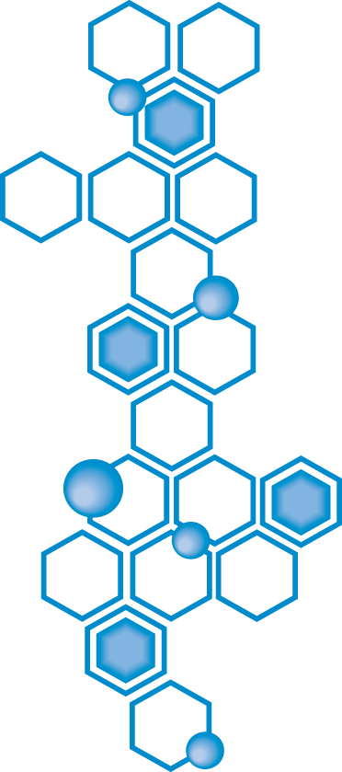
À base d'eau et de sel, comme dans nos cellules.

Slide 13
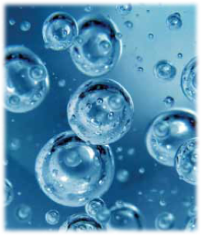
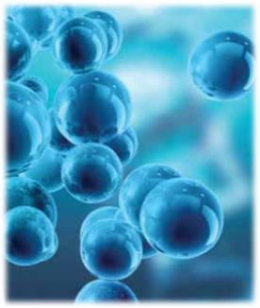
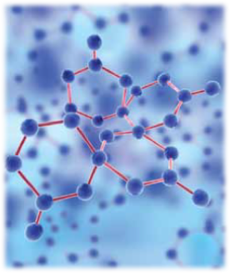
Le processus breveté en 3 étapes d'ASEA
Étape 1
Eau salée pure
(comme celle dans vos cellules)
Étape 2
L'eau salée est décomposée en atomes libres
NA-Cl-H-O
Étape 3
Les atomes sont restructurés en molécules de signalisation Redox STABILISÉES
Notes:
ASEA takes pure salt and water (the same basic ingredients your cells are made of), passes them through a heavily patented 3 day process that splits apart the sodium and chloride atoms; splits apart the hydrogen and oxygen atoms, rearranges them into 8 sets of perfectly balanced “redox signalling molecules”.

Slide 14


Slide 15
Laboratoires BioAgilytix
Situés à Durham, Caroline du Nord
Partenaires de 8 des 10 plus grandes entreprises pharmaceutiques et de biotechnologie au monde
50 % des employés ont une maîtrise ou un doctorat
Moyenne de 15 ans d'expérience postuniversitaire
www.bioagilytix.com

Slide 16

ASEA : Une percée scientifique
17 ans d'études, des millions de dollars, divers brevets internationaux...
Les molécules de signalisation Redox
permettent à vos cellules de se régénérer
sont naturelles dans le corps
contiennent peu de sodium
sont exemptes de substances interdites aux athlètes
Notes:
There is 17 years of foundational research behind this process, multilple layered international and US patents,. These molecules empower your 75 trillion cells to heal themselves. There is nothing in ASEA that is not already inside of your cells. If you could un-zip one of your cells, and pour into a glass, that would be the essence of what ASEA is!!
Many studies have shown that ASEA is 100% safe. It is safer to drink than a bottle of bottled water no matter the amount. Even though ASEA is made from salt and water, by the time the whole process is finished, there is almost no salt left in ASEA . 1 serving of ASEA contains about as much sodium as a carrot. ASEA also has done studies showing that there are no banned substances for athletes.

Slide 17

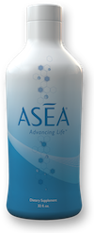
l'extérieur
de
l'intérieur
à
Notes:
so , now for the first time in history, we can feed out bodies these amazing molecules from the outside in with Renu 28 and from the inside out with ASEA!

Slide 18

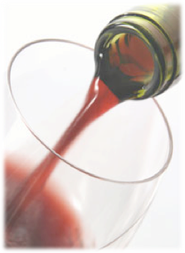
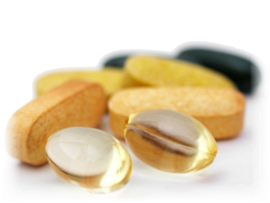
Les molécules Redox ne sont PAS
- des vitamines
- des minéraux
- des antioxydants
- des jus de fruits exotiques
- de l'eau structurée
ASEA et RENU 28 surpassent tout autre
produit de santé ou pour la peau.
Ils ont des propriétés uniques, puisque rien d'autre ne contient de molécules Redox!
Notes:
Redox Molecules are not like anything you have ever heard of before. they don’t fit into any category that you are familiar with. They are not vitamins, they are not minerals, they are not anitoxidants, this is not another type of Exotic juice, or structured water. ASEA and REnu 28 can do things that nothing else can do because they contain things that nothing else contains.

Slide 19
Les molécules Redox existent :
Dans les cellules
vivantes
Dans chaque bouteille d'ASEA
Dans chaque tube de RENU 28
Notes:
There are only a few places in the world that redox molecules exist: 1 place is inside of living cells: plants , animals, and humans. The other place is inside of every bottle of ASEA and inside of every tube of Renu 28!

Slide 20

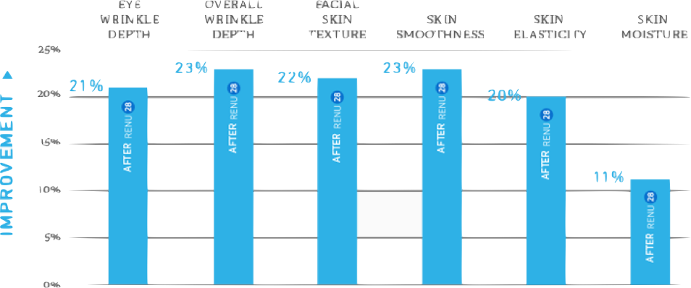

Instituts de classe mondiale en essais cliniques
Profondeur des rides sous les yeux
Profondeur globale des rides
Texture de la peau du visage
Douceur de la peau
Élasticité de la peau
Hydratation de la peau
Notes:
Stephens and Associates, Inc. ensures the successful testing of pharmaceutical, devices, cosmetics, and personal care products for safety, efficacy, and substantiation of product performance claims in clinical research Texas, Colorado, Japan
Dermatest: Results you can rely on – by a team that takes a personal interest in your success. germany
BioAgilytix We’re the scientific experts enabling scientific innovators to successfully develop, prove, and deliver life-saving, game-changing large molecule therapeutics. N Carolina
Human Perf Lab national leader in the area of nutrition and exercise immunology. exercise-induced changes in immune function, oxidative stress, and inflammation. N Carolina

Slide 21
Essais cliniques
Régénération des cellules de la peau (30 jours)
Régénération accélérée de 16 % avec RENU 28
UNE PEAU RAJEUNIE!

Slide 22
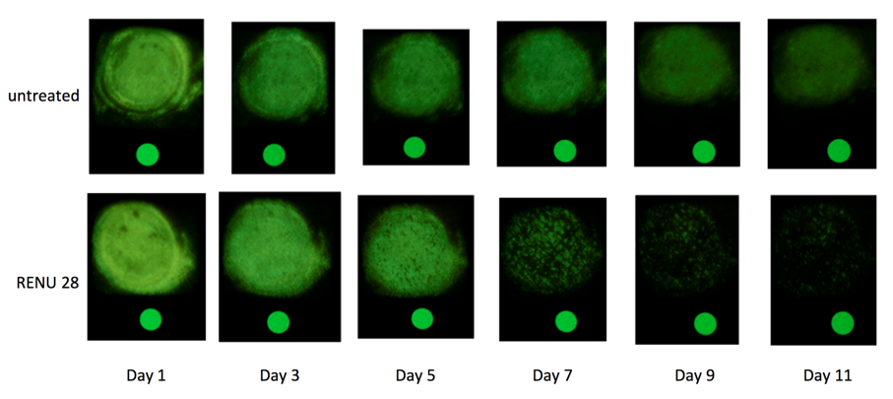
Résultats sur les cellules de la peau
Aucun traitement
Jour 1
Jour 3
Jour 5
Jour 7
Jour 9
Jour 11

Slide 23
Essais cliniques
Étude sur le flux sanguin dans la peau (4 jours)
  Amélioration de presque 50 % après une première application d RENU 28
Bienfaits d'un bon flux sanguin dans la peau
Une peau saine et radieuse
Un teint dégagé
Une réduction des vergetures et varices
Une meilleure hydratation
Une diminution de la cellulite
Une meilleure circulation dans les mains et les pieds
Une diminution des enflures et de la rétention d'eau

Slide 24
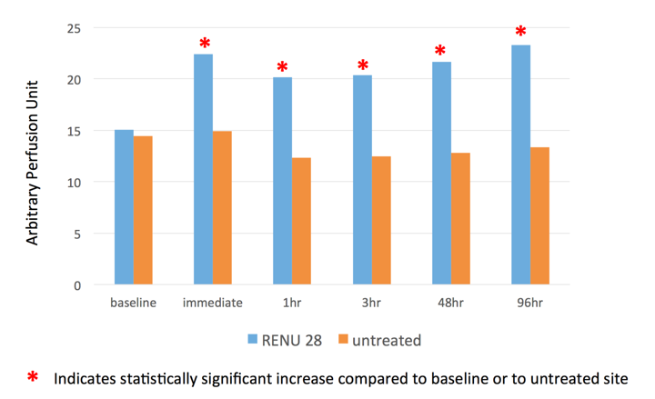
Résultats de l'étude sur le flux sanguin avec RENU 28
Zone de perfusion arbitraire
Point de départ
Effets immédiats
Aucun traitement
Indique une amélioration significative en comparaison avec le point de départ ou avec une zone non traitée

Slide 25

Essais cliniques
Améliorations de la peau faciale
Rides autour des yeux 21 % moins profondes
Rides en général 23 % moins profondes
Texture de la peau faciale améliorée de 23 %
Peau 23 % plus lisse
Élasticité accrue de 22 %
Hydratation accrue de 11 %
Notes:
1/2 way thru 12 week tests

Slide 26
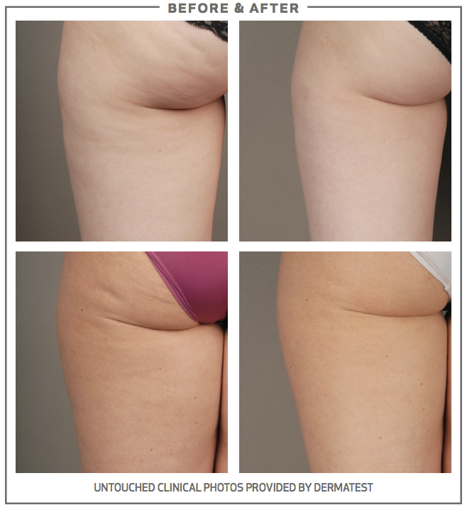

Essais cliniques
Essai RENU 28 contre la cellulite
Élasticité améliorée de 16,5 %
Diminution de la taille des lobules adipeux de 10,5 % à 12 %
Notes:
1/2 way thru 12 week tests

Slide 27
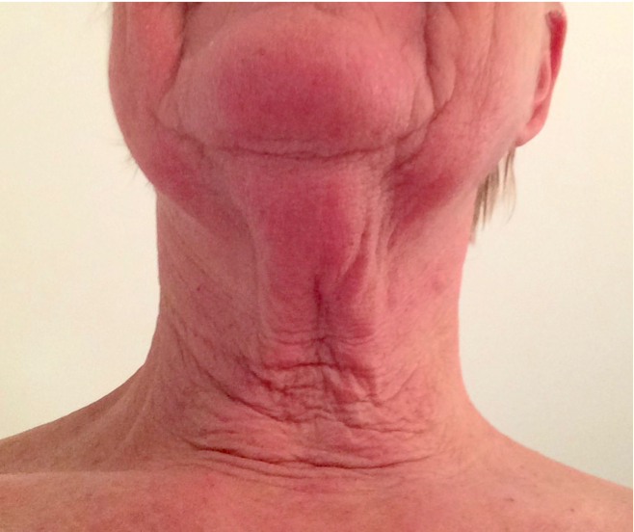
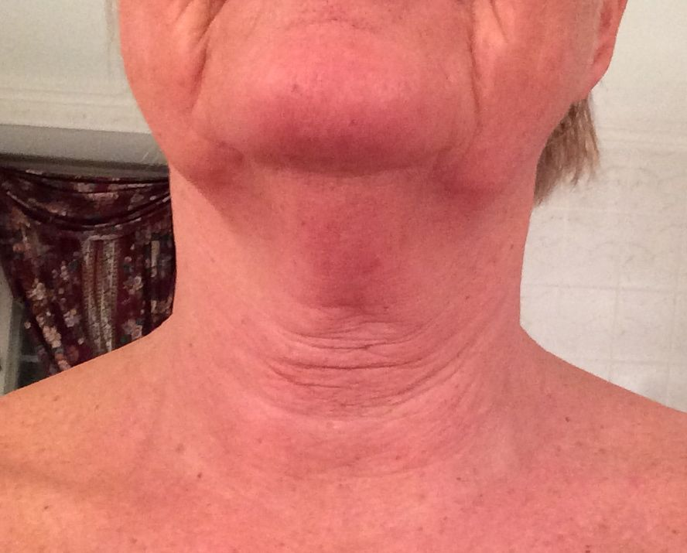
RENU 28
19 mars 2014 16 avril 2014
Notes:
Who would like to lessen the visible signs of aging? we all would! Look at this man after only a few weeks of using Renu 28. If Redox molecules can erase the visible signs of aging, what might they do for the invisible signs of aging?

Slide 28
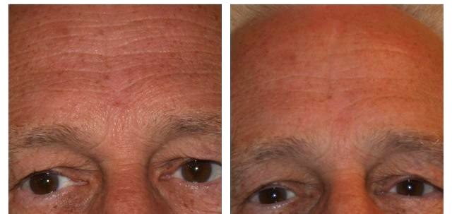
RENU 28
Notes:
Who would like to lessen the visible signs of aging? we all would! Look at this man after only a few weeks of using Renu 28. If Redox molecules can erase the visible signs of aging, what might they do for the invisible signs of aging?

Slide 29
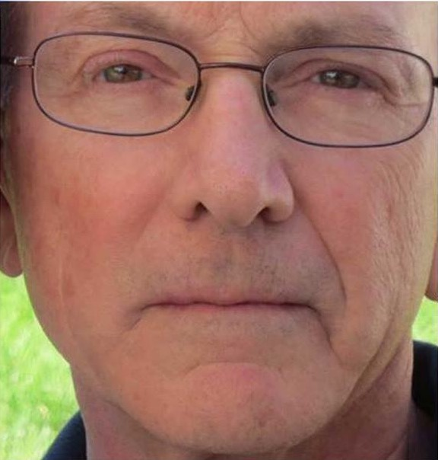
RENU 28
Aucun
RENU 28
RENU 28

Slide 30
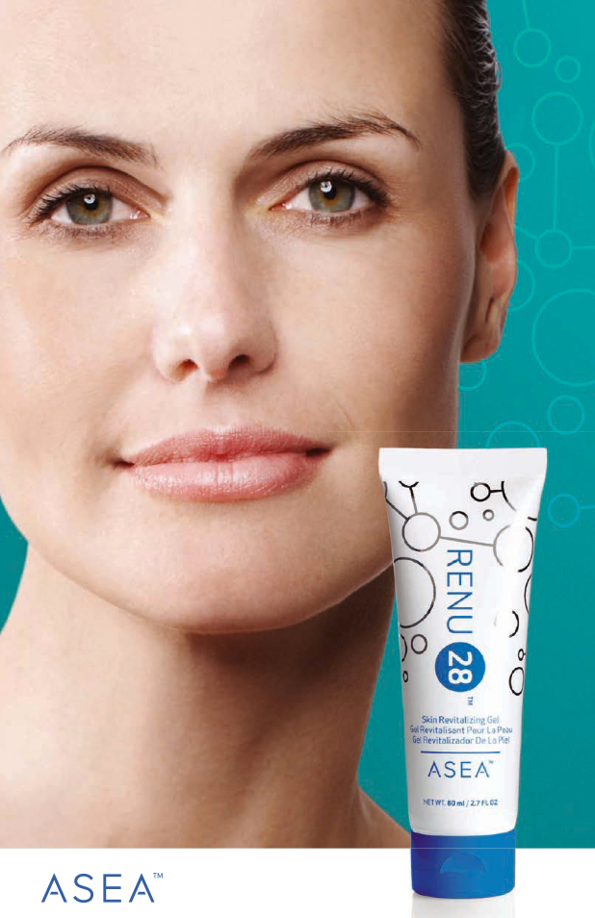

Ce gel pour la peau
unique fonctionne grâce
à la technologie de signalisation Redox
Certifié SANS DANGER
Complètement non toxique
Non inflammatoire
Fait de 4 ingrédients seulement

Slide 31
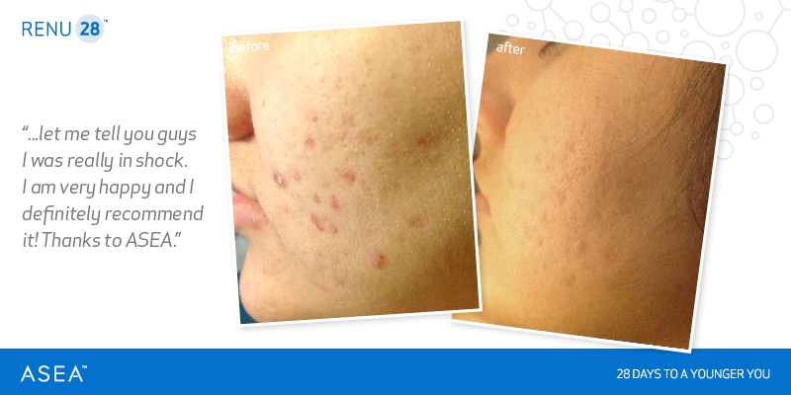
« Laissez-moi vous dire que j’étais sous le choc. Je suis très heureuse et recommande chaudement le produit! Merci à ASEA. »
Notes:
Younger people with skin issues: renu 28 can change their whole life, not just their appearance!

Slide 32
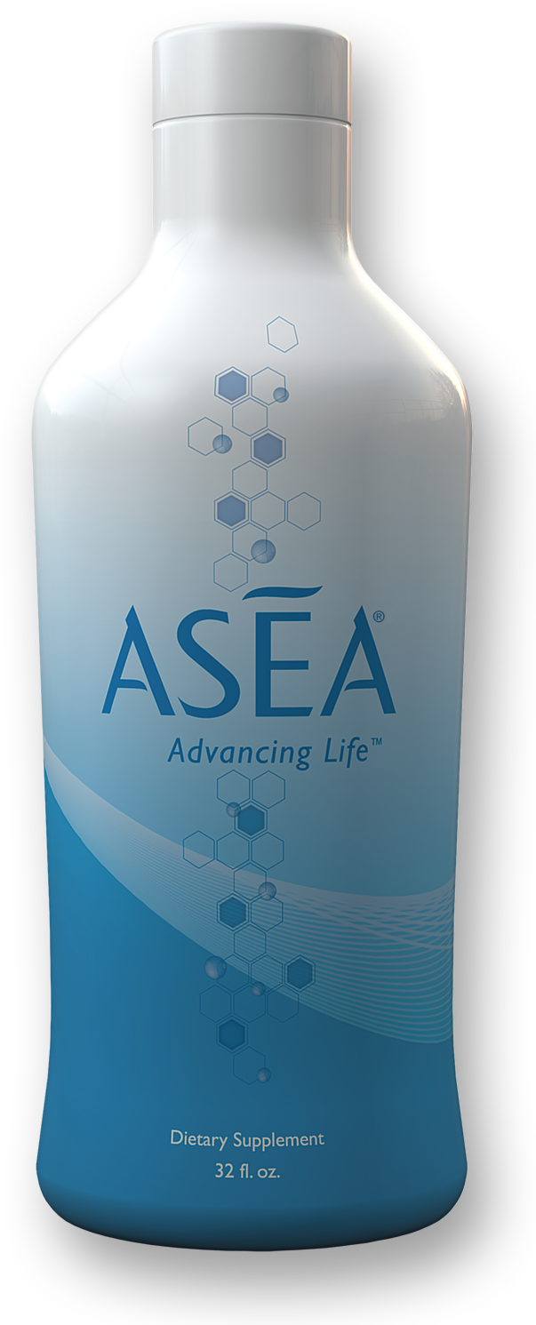
RENU 28 est un gel pour la peau et ASEA, un supplément Redox
Ils utilisent tous deux la même technologie de signalisation Redox.

Slide 33
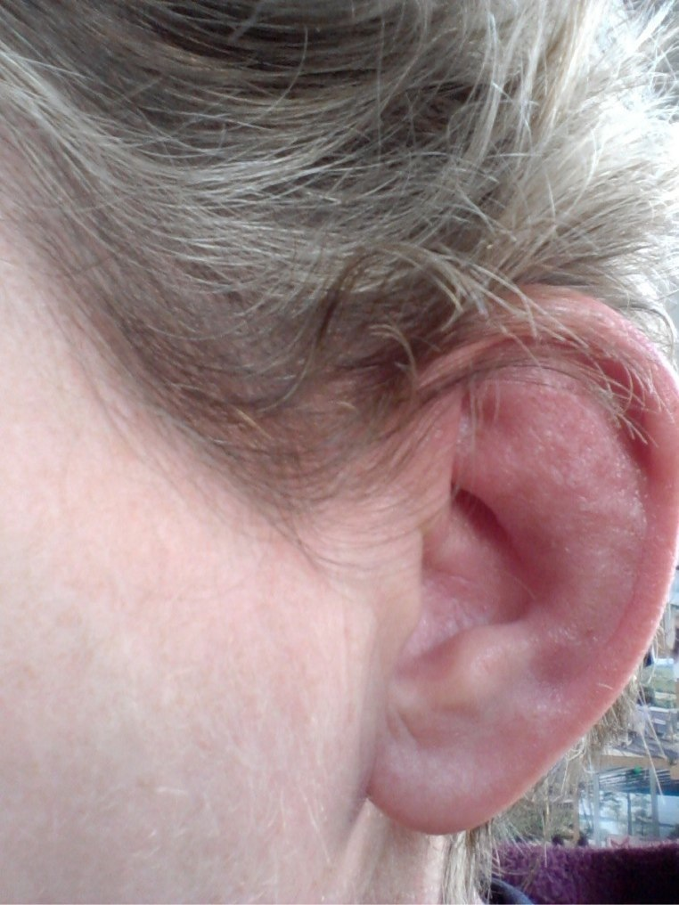
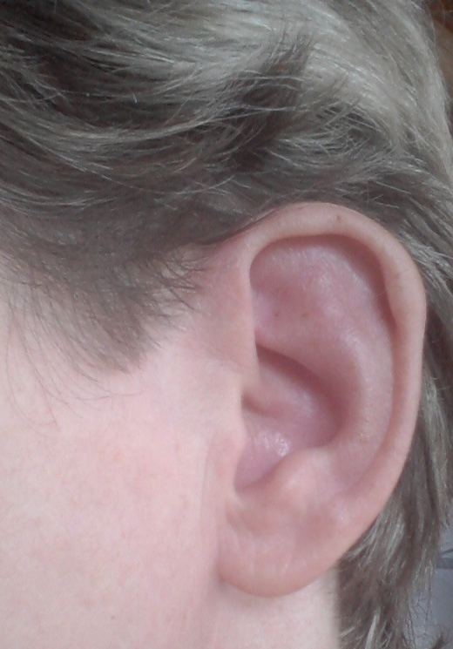
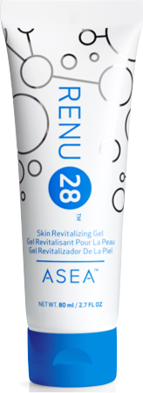
09.05.2014
23.05.2014

Slide 34
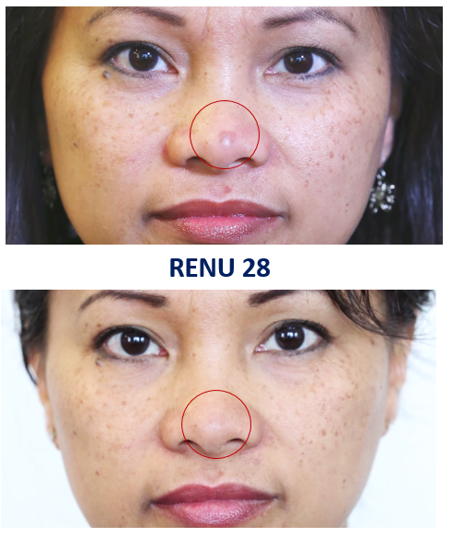
RENU 28

Slide 35
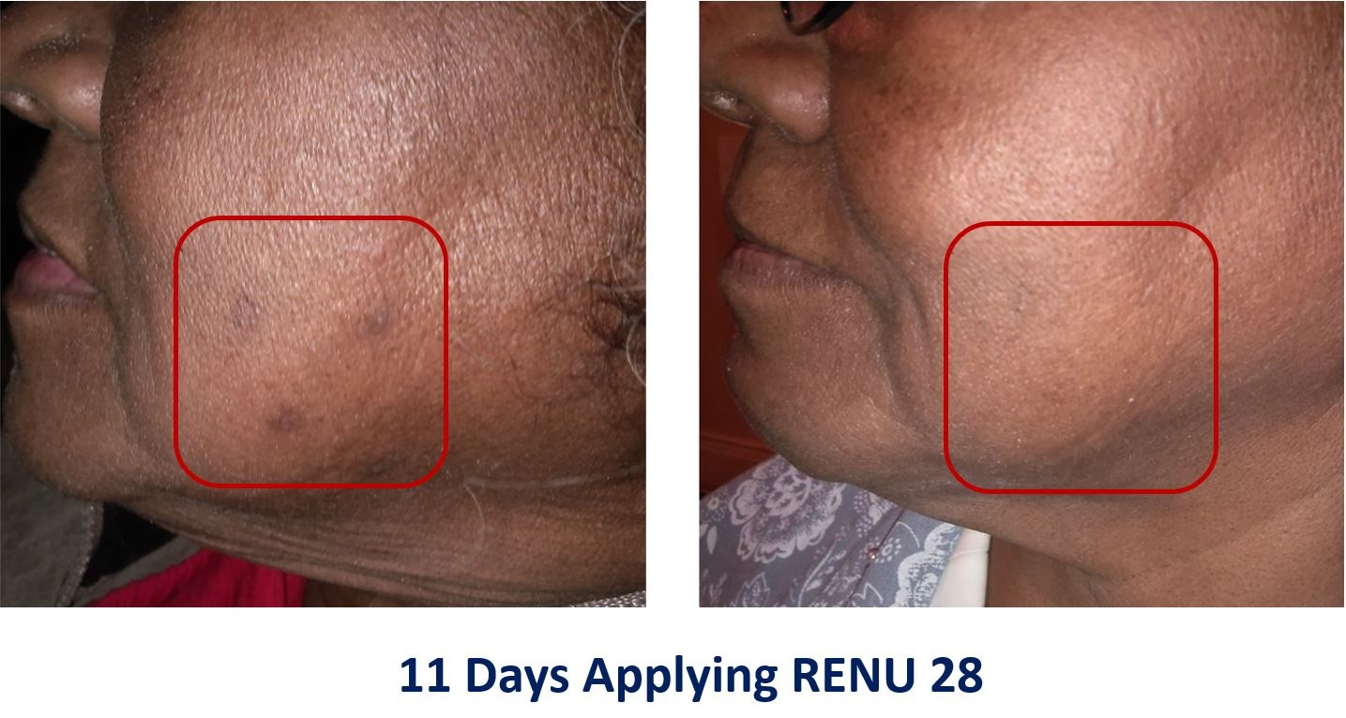
RENU 28
Notes:
This woman had some type of growth on her cheek. after using Renu 28 for a few weeks, healthy tissue was restored. Redox Molecules repaired and replaced the damaged cells. Some people have growths on the outside of their body. Others have growths that they may or may not be aware of on the inside of their body. …

Slide 36
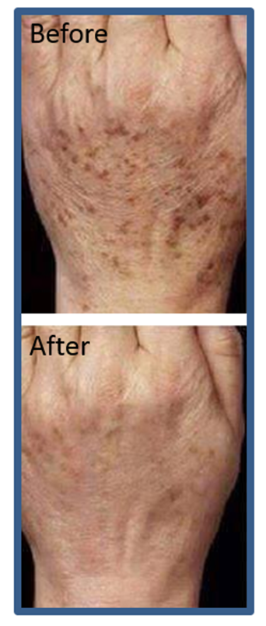
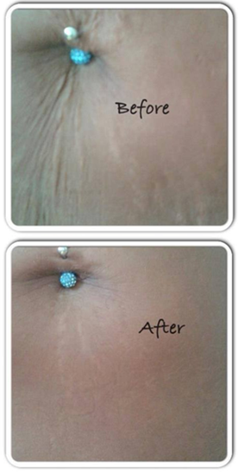
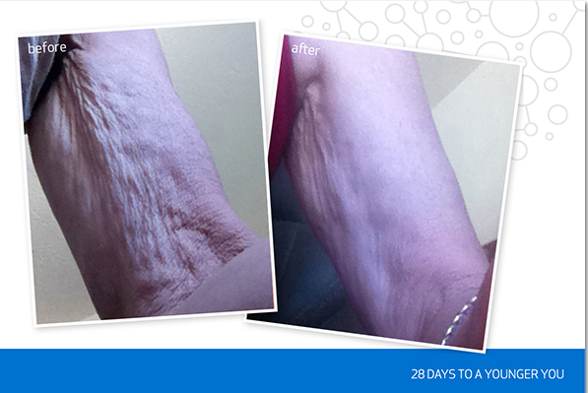
RENU 28 n'est pas seulement pour le visage!

Slide 37

Qu’arrive-t-il à notre corps lorsque nous buvons les mêmes molécules qu’on retrouve dans RENU 28?

Slide 38
Les gens constatent moins de fatigue, un sommeil amélioré, un moral remonté, une amélioration de leur santé et moins d’inconforts.

Slide 39
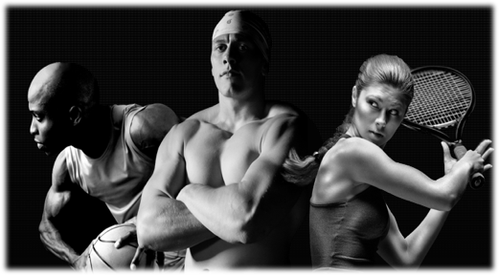
ASEA est excellent pour les athlètes
ASEA permet aux athlètes d'accroître de manière considérable leur...
endurance
force
temps de rétablissement
endurance mentale
* ASEA est fait d'eau et de sel, donc ne contient aucune substance interdite.

Slide 40

ASEA transforme des vies à l'échelle mondiale
Notes:
-Lives changed
-Global commissions
-Examples of who connected me to peeps here at this meeting

Slide 41
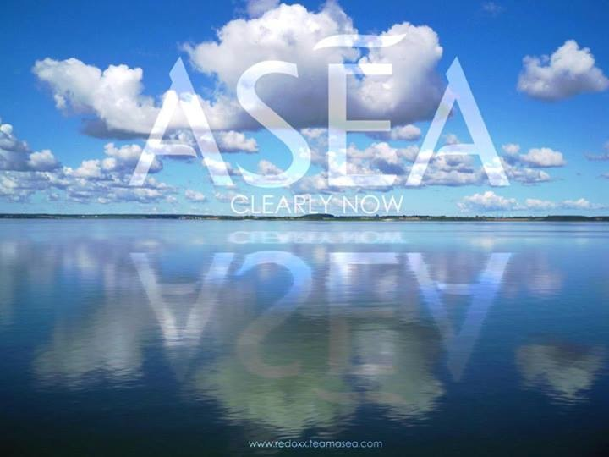
ASEA et Renu28 ne sont pas destinés à diagnostiquer, traiter, guérir ou prévenir les maladies ou conditions médicales.
Notes:
Compliant testimonies

Slide 42
Ayez des attentes raisonnables
90 %+
75-85 %
50-65 %
10-15 %*
* Les études ont démontré des effets positifs immédiats, mais ceux-ci ne sont pas toujours ressentis tout de suite.
Notes:
Be sure to set correct expectations. sometimes we hear about people who have had major miracles very quickly and sometimes that happens to a small percentage of people, but always let people know that they need to make a commitment to use the products correctly and consistently for at least 90-120 days

Slide 43
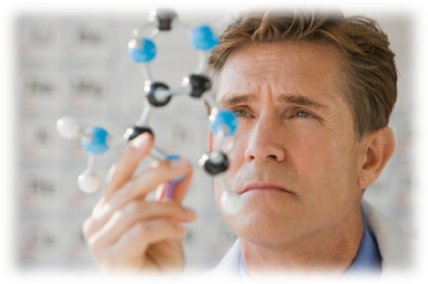
La technologie de signalisation Redox
Différente
Véritablement révolutionnaire
Toute nouvelle science
Profitable à long terme
Plusieurs brevets
Aucune concurrence
Aucun produit semblable
Avantageuse
Des résultats notables
Amélioration immédiate du flux sanguin
Taille des lobules adipeux diminuée en quelques semaines
Meilleure régénération des cellules
Notes:
The long term success of any product or company depends on a combination of 3 critical elements: it must be truly different, that difference must be sustainable, and that difference must provide an obvious advantage to the consumer. ASEA has all 3 of these in abundance.
ASEA’s Redox Signaling Technology is based a new frontier of science. It is heavily patented, with multiple US and international patents. ASEA has zero completion, no copy cats. There is now where in the world you can get redox signalling products except from ASEA. And last but not least, ASEA products deliver meaningful results.

Slide 44



ASEA et Renu 28 visent plusieurs marchés de trillions de dollars
Santé et bien-être
Rajeunissement
Souci de la santé
Problèmes de santé
Prévention
Cosmétiques
Rajeunissement
Peau lisse, en santé
Diminution des rides
Meilleure texture
Sportifs et athlètes
Performance
Endurance
Rétablissement
Réparation

Slide 45
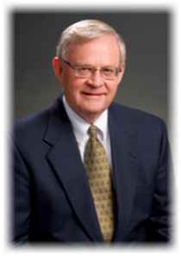
Le visionnaire qui a fondé ASEA
Verdis Norton
Cadre Fortune 50
Notes:
ASEA was Founded by Verdis Norton , a Fortune 50 Executive who was the head of strategy and corporate re-engineering during his career with Kraft foods, a 36 billion dollar company. Verdis had the opportunity to sell Redox Signalling technology to a pharmaceutical company, but realized the technology would not reach it’s full potential in the pharmaceutical realm, so he made the decision, from a sense of principles and purpose, to bring redox signaling technology to the world through a network distribution channel.

Slide 46
ASEA : Entreprise à longue vie, stabilité et momentum
Réalités ASEA
Projection
Lancement en Union Européenne
Lancement Amérique du Nord
Momentum
Notes:
ASEA pre-launched in 2009, a very challenging time for global economy. Because of Verdis Norton’s influence, ASEA has been managed with Fortune 50 business disciplines. ASEA was debt free after 9 months, and has enjoyed significant growth every single year. ASEA’s objective is to become a long term, sustainable, legacy company, and to provide stability year after year for those who wish to enjoy ASEA’s products, and for the Associates who choose to engage in ASEA’s unprecedented business opportunity, and for those who enjoy the opportunity for personal growth and the opportunity to live a purpose filled life.

Slide 47

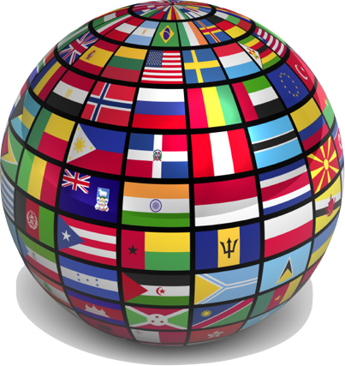
Plan stratégique pour 2015 :
Devenir chef de file mondial en technologie de santé cellulaire à base de molécules Redox
Notes:
ASEA’s 2015 Strategic Plan is to become the Recognized Global Leader in Redox Based Cellular Health Technologies. Many people have never heard the term “redox based cellular health technologies” before. This is a new technology that will be explained in detail in upcoming slides.

Slide 48

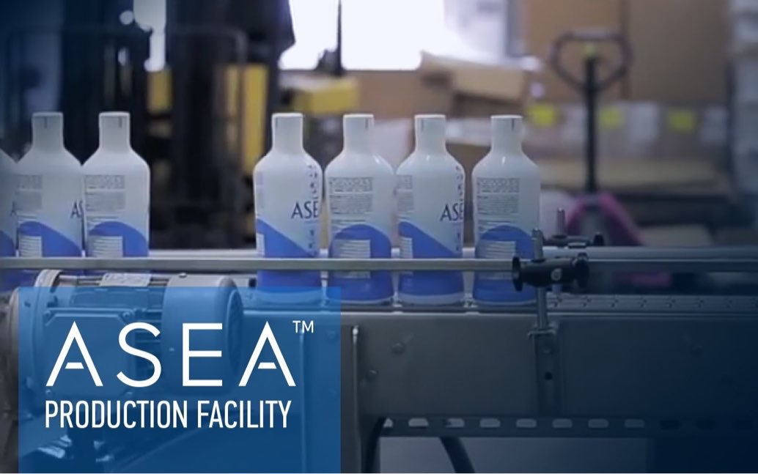


Certifié NSF
Approuvé par la FDA, cachère
Manufacture ASEA
Pleasant Grove, Utah, États-Unis
Notes:
ASEA’s one-of-a-kind, in-house manufacturing plant it located in Pleasant Grove UT. This is the only place in the world where balanced, stabilized redox signaling molecules are manufactured
http://aseaglobal.com/en-us/science/production.aspx

Slide 49


Concentration Infrastructure Distribution
Distribution des produits ASEA
12 centres d'expédition et de distribution mondiaux
Notes:
Then ASEA ships the product by boat to 12 distribution centers around the world: (Aus/NZ off the map)
6 in North America : Salt Lake City UT, Memphis TN,
San Juan PR, Honolulu HI, Toronto Canada, Guadalajara Mexico
4 in Europe: Budapest , Oslo, London, Netherlands Oslo Norway
1 in Sydney Australia . 1 in Auckland New Zealand

Slide 50

Sièges sociaux ASEA
Amérique du Nord : Salt Lake City, Utah
UE : Munich, Allemagne
Notes:
ASEA has 2 corporate headquarters: one in SLC UT, one in Munich Germany

Slide 51





Fabricant
Télévision,
radio
Télé-
marketing
Revues,
journaux,
poste
Clients
Marketing relationnel
Notes:
ASEA manufactures the product. Their goal is to get it to customers. Instead of spending money on traditional forms of advertising, ASEA depends on us to share with others. Word of mouth is still the most powerful form of advertising. who heard about ASEA from someone you have a relationship with? a relative, a friend, a co-worker? (almost everyone raises their hand)

Slide 52

Notes:
One of the reasons ASEA chose this form of distribution is because of the “Global Censorship of Health Information”. You can google the title of this book to purchase it , or simply to get a summary of what it says. Essentially the multi billion dollar pharmaceutical companies around the world lobby governments to make laws that are favorable to them, so that even if a natural product , like a prune, is know to help people stay regular, it is against the law for a prune company to do studies or publish information showing that prunes have medical benefits. By law, only pharmaceutical companies are allowed to do studies and claim that their products have medical benefits.

Slide 53


La vision ASEA
« Plus vous aidez les gens à obtenir ce qu’ils désirent, plus vous avez de succès. »
– Zig Ziglar
Notes:
Our Vision is to take ASEA around the world. This all started in July 2009 when one person in SLC started telling her friends about ASEA. Today , 5 1/2 years later, ASEA is in 25 countries, has done over 200 million in cumulative sales, and almost 200,000 people have used our products. all by word of mouth. all based on Zig Ziglar’s famous statement “you can have everything you want if you just help enough other people get what they want.”

Slide 54

ASEA transforme des vies à l'échelle mondiale
Amérique du Nord
États-Unis, Canada, Mexique
Europe
Allemagne, Autriche, Belgique, Croatie, Danemark, Espagne, Finlande, France, Hongrie, Italie, Irelande, Norvège, Pays-Bas, Portugal, République tchèque, Roumanie, Royaume-Uni, Slovaquie, Suède
Australie, Nouvelle-Zélande
Notes:
ASEA is changing lives around the world! Currently in 25 countries , ASEA is committed to Global Expansion

Slide 55

ASEA a accédé au palmarès mondial du DSN (meilleures entreprises de marketing relationnel au monde).
Notes:
According to www.mlmrankings.com ASEA is now one of the top 100 Networkwork Marketing companies worldwide out of 2800 companies after only 5 years.

Slide 56


Plan de rémunération ASEA
50 %
du volume de vente global
Total Global Volume
versé aux collaborateurs

Slide 57

La généreuse rémunération d'ASEA
* Ces renseignements sont fondés sur les revenus des associés cadres ASEA en 2014. Il ne s’agit pas d’une garantie de revenu en particulier; les résultats varient selon les individus.
Notes:
If you’re like most people, you’re used to relying on a regular paycheck from an employer. But that norm is becoming less and less normal as more and more people are looking for—and creating—multiple income streams.
ASEA’s generous compensation plan gives you multiple ways to earn. It’s a great way to put your residual income plan into place, relying on ASEA’s remarkably high retention rate, more than triple the 15–20% industry average.
At every level of ASEA’s compensation plan, you can bring in extra income, from a few hundred to a few thousand dollars a month. Average commissions* at ASEA’s executive ranks look something like this:
The ASEA compensation plan has also supported and rewarded many individuals who have committed themselves full-time to business-building, and as a result, have achieved financial independence. ASEA has even created an elite Million-Dollar Earners Club.
The customer base is unlimited, and the powerful, generous commission and bonus structure rewards Associates every step of the way.

Slide 58



Revenu résiduel optimisé
Vous
une heure
1 h
+3 h
+9 h
+27 h
Soyez PAYÉ pour 40 h
Jack
une heure
Jill
une heure
Joe
une heure
Une
Une
Une
Une
Une
Une
Une
Une
Une
One
One
One
One
One
One
One
One
One
One
One
One
One
One
One
One
One
One
One
One
One
One
One
One
One
One
One
Créez une ÉQUIPE!
Notes:
JP Getty said “ I’d rather earn 1% of the efforts of 100 people rather than 100 % of my own efforts. “ Most people don’t know how to create leverage. they just go and get a job. when they are done working, they are done getting paid. leverage is the magic ingredient! build a team so that everything doesn’t depend only on your own efforts!

Slide 59

Robert Kiyosaki
« Les gens les plus riches au monde cherchent et bâtissent des réseaux. Les autres se cherchent du travail. »
Notes:
Ask: how can the average person create a lucrative network?
Most of us could never afford to build a TV network , or a radio network.
Answer: Network Marketing! ASEA!!!
What is needed? A small investment, small monthly overhead (autoship, attend events) + “sweat equity”

Slide 60

Comment pouvez-vous vous joindre à ASEA?
Bâtisseur de fortune à temps plein
Créez une équipe nationale ou mondiale
Bâtisseur d'activité commerciale à temps partiel
Aidez les autres en gagnant votre vie
Client
Bénéficiez d'une meilleure santé

Slide 61

ASEA révolutionne le monde, une cellule à la fois

Slide 62

ASEA peut transformer votre vie.
Notes:
We invite you to join our ASEA family! We need everyone to join us in this great cause, this great mission. By changing other’s lives, you can significantly change your own. Get with the person who invited you to this presentation. They will go over the cost of purchasing the product at retail and wholesale pricing, and/or becoming an Associate. Thank you very much for investing your time with us today!

