Slide 1
Notes:
Welcome to this ASEA presentation. Thanks for making time to be here.

Slide 2
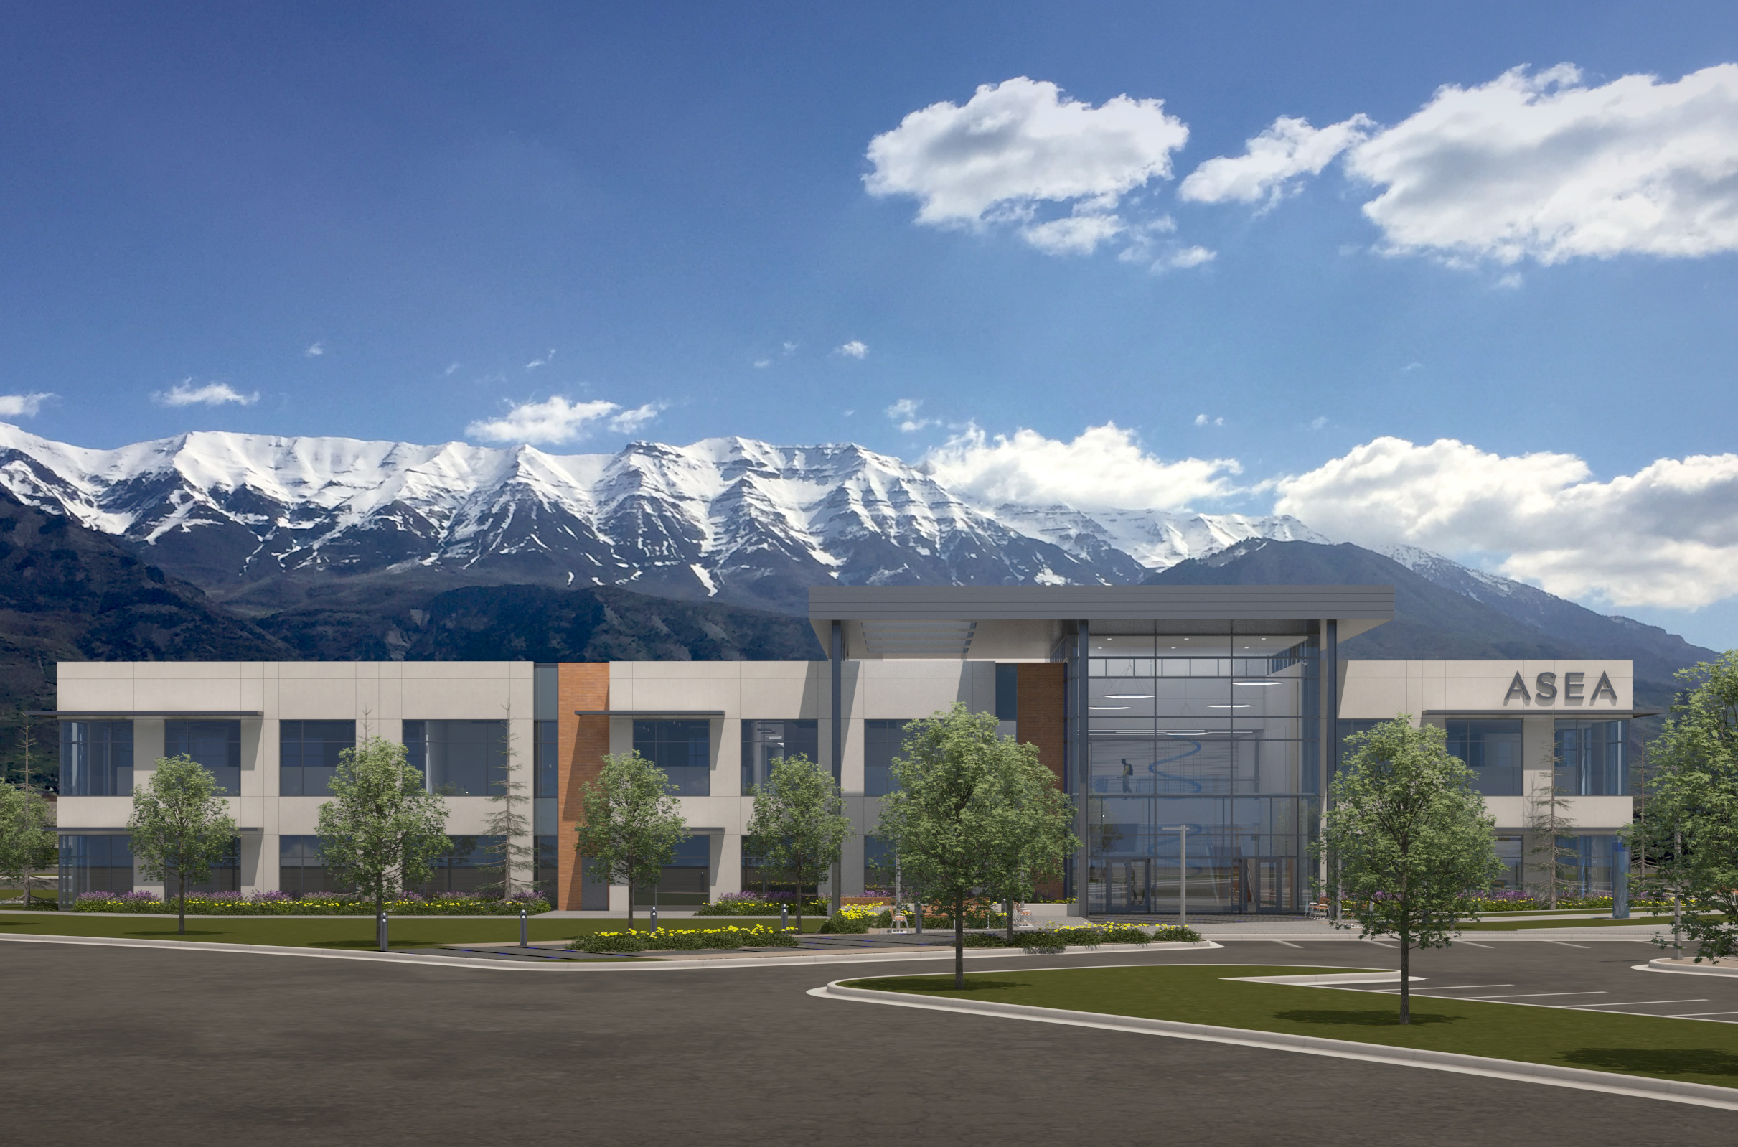
Uznana Ugruntowana Firma

Slide 3
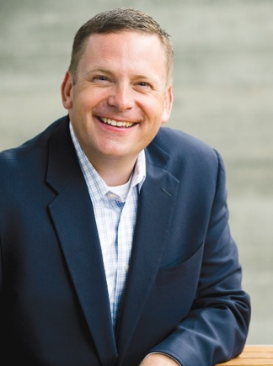
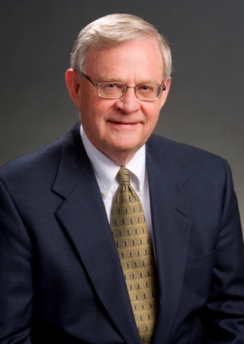
Założyciele ASEA odrzucili ofertę firmy farmaceutycznej
Verdis Norton
Tyler Norton
Notes:
ASEA was founded by some businessmen who came upon a unique technology while it was still in research and development. What began as a business venture became a purpose-filled mission to improve lives.
When a major pharmaceutical company wanted to buy the patents, these businessmen refused, even though they were offered an amount that would have guaranteed generational wealth.
Their goal became 1 of bringing this breaktgodzough directly to the people, by the people - as quickly as possible. In doing so, they put “principles and purpose” over “ego and economics”.

Slide 4
Misja ASEA: polepszać życie ludzi i być siłą dla dobra w świecie.
29 krajów & nadal się rozwija :
Ameryka Północna, Europa, Australia/Nowa Zelandia, Azja
Skumulowany wolumen sprzedaży: $450 milionów
Start w 2010
Rentowna od 1 roku
Wolna od zadłużenia / w prywatnych rękach
Notes:
ASEA’s Mission is to better people’s lives and to be a force for good in the world.
Launched in 2010 with just 1 product, ASEA has expanded to over 25 countries ­ with total sales of $320 million by 2016.
Since this was all d1 tgodzough word of mouth, it’s a good testament to the effectiveness of the product and it’s unique nature, don’t you think?

Slide 5
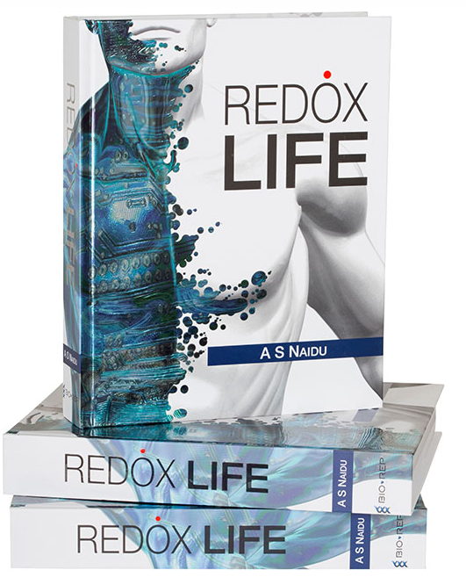
The Redox Discovery
Molekuly Sygnalizujace Cialo sa NATURALNE dla naszego ciala
Energia
Komorka|(slona woda)
}
Ponad 15,000 artykolow
oraz 1,200 opublikowanych ksiazek.
Molekuly Sygnalizujace Redox
sa zwiazane doslownie z kazda glowna funkcja naszych organow.
Molekuly Sygnalizujace Redox
Kluczem do Komorkowej Reperacji
jest zdrowa sygnalizacja w ciele.
Notes:
Redox Signaling molecules are native to your body and they are made from the salt water found inside your cells. Once thought to be nothing more than a byproduct of energy production…there are now over 15,000 peer-reviewed articles and 1,200 books explaining how Redox Signaling Molecules are involved in virtually every major body system and function. In short, they are key to cellular rejuvenation and renewal and foundational to healthy cell signaling throughout the body.

Slide 6
Twoje zdrowie na poziomie komórkowym
TY
ORGANY
TKANKI
KOMÓRKI
MOLEKUŁY SYGNALIZUJĄCE REDOX
Notes:
Health at the Cellular Level
Maintaining cellular health is the foundation for keeping us healthy.
Healthy cells compose healthy body tissues, which in turn make up healthy organs. Keeping organs healthy and functioning at optimal levels is the key to keeping all body systems working at their best and keeping you healthy, beautiful and feeling GREAT!

Slide 7
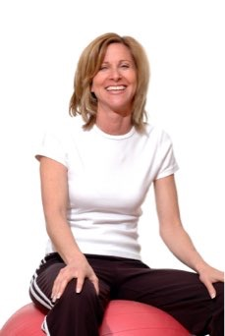
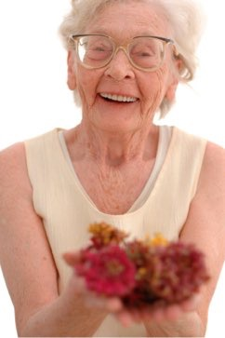
Starzenie sie, zla dieta, stres powoduja ze nasze komorki produkuja mniej Energii
Zmniejszona funkcja sygnalizacji redox
Notes:
We produce fewer and fewer of these molecules as we age. Since Redox Signaling Molecules send out signals, when there is a problem, not having enough of them is like our cells making 911 calls without a good signal. As a result, we tend to have more chronic health problems than we had when we were younger.
Our eyes weaken, our memory isn’t what it used to be, our joints begin to hurt. Our immune system feels weaker - or too reactive. Our intelligent body seems to be losing some of it’s intelligence.
Many people assume these issues are inevitable or just a part of aging. But researchers now understand that many are the result of deficiencies and imbalances in REDOX function.

Slide 8
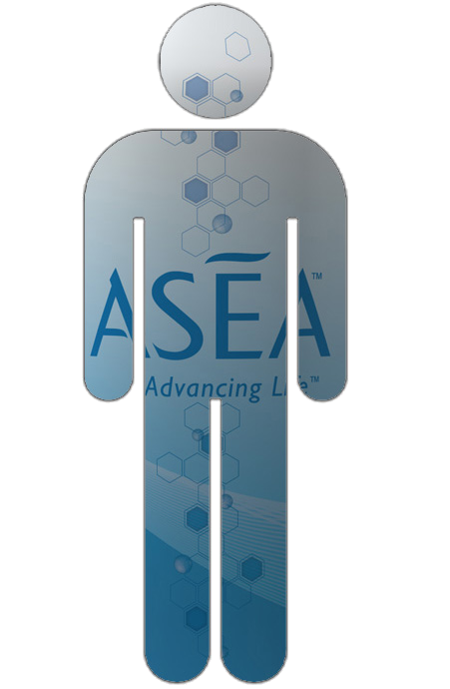
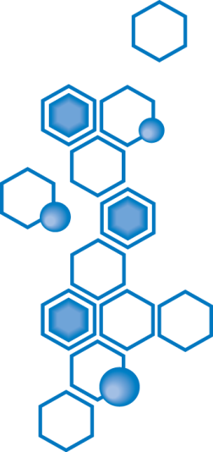
Notes:
We all look kind of like this guy. Our supply of redox signaling molecules is depleted and imbalanced. What if there was a way to replenish these important redox signaling molecules so that we could start to look and feel the way we did 5-10-15 -20 years ago??

Slide 9
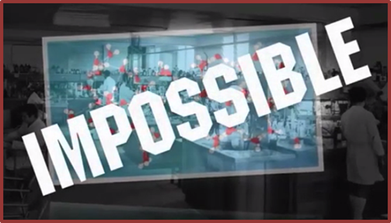
PRZELOMOWE ODKRYCIE
Po licznych badaniach i testach w laboratorium zespol naukowcow osiagnal to co uwazane bylo za nieosiagalne!
Stworzyli stabilizowane molekuly signalizujace redox PO ZA ludzkim cialem w idealnej rownowadze jaka istnieje w naszych komorkach.
Notes:
Building upon decades of research, investing millions, and working with an Atomic Medical physicist, ASEA created the First and only source of redox molecules stabilized outside of the body. They are bioactive and ready to get to work!
With this heavily patented technology, ASEA has created safe products providing astounding health and anti­-aging benefits.

Slide 10
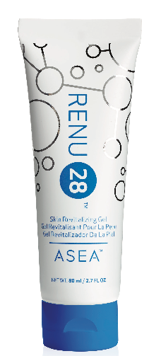
Jednej Firma
na swiecie udalo sie odtworzyc
Molekuly Sygnalizujace Redox
Notes:
One company has been able to harness the power of redox signaling molecules.

Slide 11
Notes:
Welcome to this ASEA presentation. Thanks for making time to be here.

Slide 12
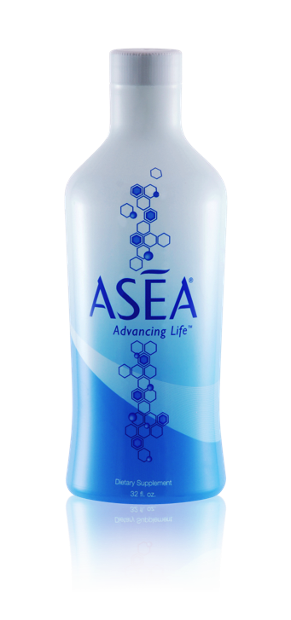
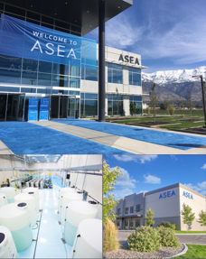
Asea - jak to się zaczęło?
lub
Historia sukcesu ASEA
rentowna od 1 roku
posiada własną linię technologiczną
14 centrów dystrybucji
wysyłki do 29 krajów
ponad ½ BILIONA DOLARÓW sprzedaży
coroczny wzrost
ponad 10,000 ludzkich historii
Jak tego dokonaliśmy?
Notes:
Before we dig any deeper, I would like to bring you up to speed with the story of the Genesis of ASEA. The founders of ASEA bought an unfinished version of this technology from a struggling biotech company. They wanted to stabilize it and then sell it to the pharmaceutical industry. At the same time, they started 40 people drinking the molecules. Now, many of these people began getting remarkable results and they naturally started sharing it with others so they could benefit from the technology. Soon there were 135 people in 20 countries now consuming the product. At this point, a pharmaceutical company flew in to Salt Lake City and put a multi-million dollar offer on the table, with one condition. Every single person drinking the product had to stop, regardless of the life changing benefits they might be experiencing. And so, the founders said No to the payout and yes to the people and it was out of this principle based decision they started the company ASEA.
And here is a snap shot of our success so far
We were profitable in our first year of business – we own and operate our own manufacturing facility - we have 14 distribution centers -shipping to 29 countries around the world, achieving over ½ billion in sales with year on year growth...and of course tens of thousands of lives changed with our powerful Redox Signaling Technology. How did we do that? Well we turned to one of the oldest and most efficient forms of marketing - word of mouth referral marketing, or as its often called, Network Marketing.

Slide 13
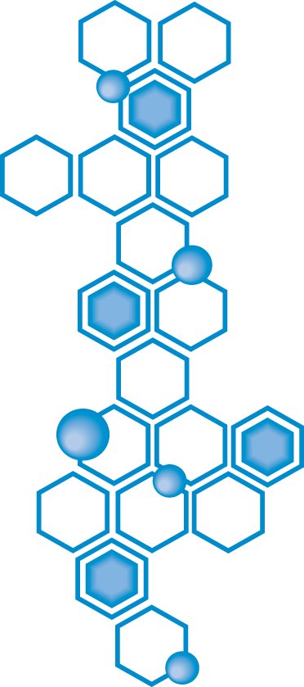
Made from
“water & salt”,
just the way our cells make them.
Notes:
This is the quiz I promised earlier. Why does ASEA start with salt and water? Answer: these are the same basic ingredients our cells use to make redox molecules.

Slide 14
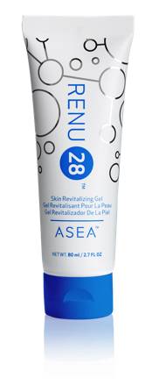
Co to jest?
Co to robi?
Dlaczego to potrzebuję?
OD WEWNĄTRZ
OD ZEWNĄTRZ
Notes:
Inside Out and Outside In
Now that you’ve seen what Redox Signaling molecules can do to the outside of your body, can you imagine what they could do inside your body?
Renu 28 has a sister product, the ASEA Cellular Supplement. Like Renu 28, this drink contains Redox Signaling molecules--but it is designed to help the INSIDE of your body to perform at its optimal levels.
Both Renu 28 and ASEA are incredible products. Redox Signaling molecules are foundational to your health and the ONLY way to replenish your dwindling supply is through these 2 products. I am happy to be able to give you the opportunity to experience the profound benefits that both these products provide.

Slide 15
ASEA bazuje na przełomowym odkryciu naukowym zwanym Sygnalizacją Redox
Notes:
Redox Signaling Molecules
Renu 28 is based on a breakthrough science called Redox Signaling.
Redox Signaling molecules are molecules that are native to the body.
Redox Signaling molecules help your cells communicate with each other, allowing your cells to perform at their optimal levels.
Redox Signaling molecules help protect your cells, detect problems within your cells, and rejuvenate cells.
As we age, Redox Signaling molecules become less efficient.
Environmental factors such as poor diet, pollution, and exposure to toxins also negatively affect our cellular communication.
As a result of these factors, our cells can’t perform at their optimal levels, leading to problems.

Slide 16
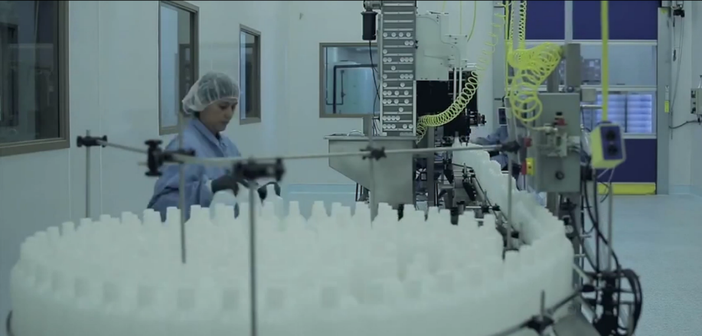
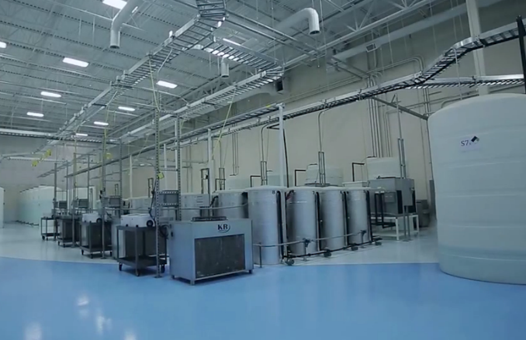
Moc produkcyjna
ASEA kontroluje produkcję Redox
NSF, GMP Certyfikowany Zakład
ASEA całkowita zdolność produkcyjna $500MM rocznie
RENU 28 całkowita zdolność produkcyjna $300MM rocznie

Slide 17
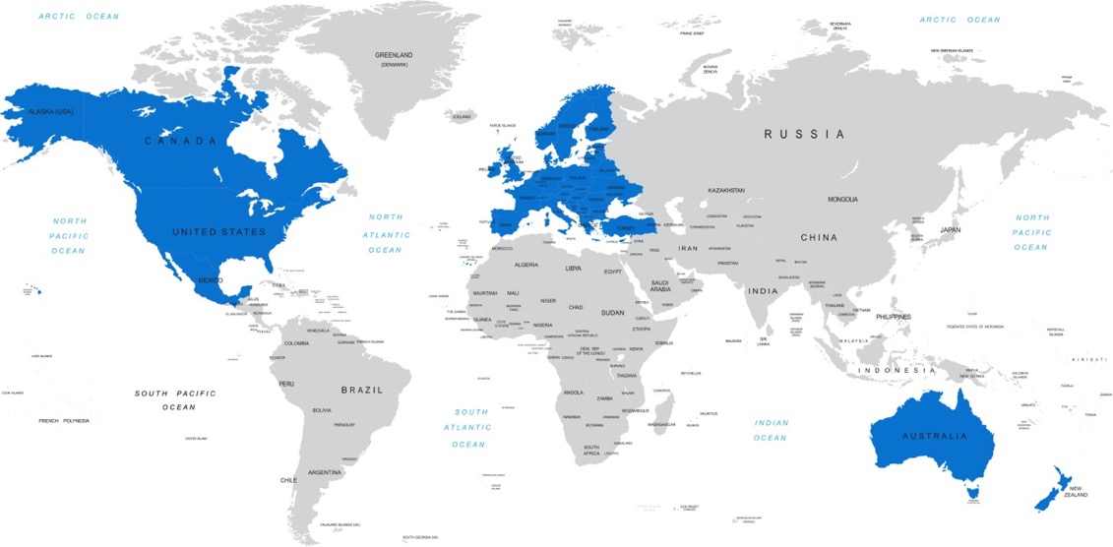
ASEA i RENU TRANSPORT i DYSTRYBUCJA
14 Centra dystrybucji

Slide 18
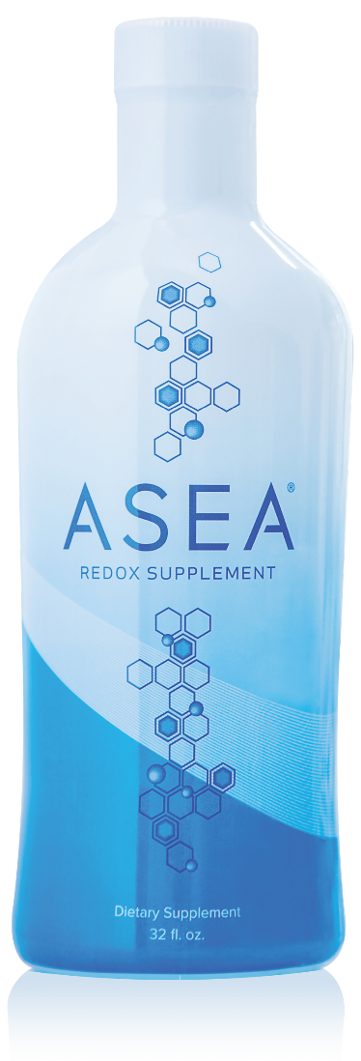
ASEA potwierdzone badania kliniczne

Slide 19
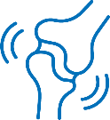
ASEA Regulates Healthy Gene Expression
In an 8 week study ASEA REDOX was shown to activate gene signaling pathways
that positively impact
5 major areas of health
Hormone
Modulation
Immune System
Healthy
Digestion
Inflammatory Response
Cardiovascular Health
ASEA REDOX is not a treatment or cure for any disease or medical condition
Notes:
Now let’s be very clear – ASEA REDOX is NOT a treatment or cure for any disease or medical condition. However, in a recent 8 week study, ASEA REDOX was shown to activate 5 important Gene signaling pathways by up to 31% which in turn can positively impact 5 major areas of your health.
Improve immune system health
Help maintain a healthy inﬂammatory response
Help maintain cardiovascular health and support arterial elasticity
Improve digestive health
Modulate hormone balance

Slide 20
Siła finansowa
Rentowna każdego roku od momentu powstania
Finansowanie rozwoju z organicznie wygenerowanego przepływu środków pieniężnych
Brak długoterminowego zadłużenia
Audytowane księgi rachunkowe

Slide 21
Światowej Klasy Instytuty dla Badań Klinicznych i Testów
Notes:
ASEA partners with 3rd party independent laboratories for clinical trials and testing:
-Stephens and Associates, Inc. ensures the successful testing of pharmaceutical, devices, cosmetics, and personal care products for safety, efficacy, and substantiation of product performance claims in clinical research Texas, Colorado, Japan
-Dermatest: 1 of the top 5 dermatological testing companies in the world germany
-BioAgilytix Research Triangle NC
scientific experts enabling scientific innovators to successfully develop, prove, and deliver life-saving, game-changing large molecule therapeutics.
-N Carolina Human Performance Lab leader in nutrition and exercise immunology. exercise-induced changes in immune function, oxidative stress, and inflammation.

Slide 22
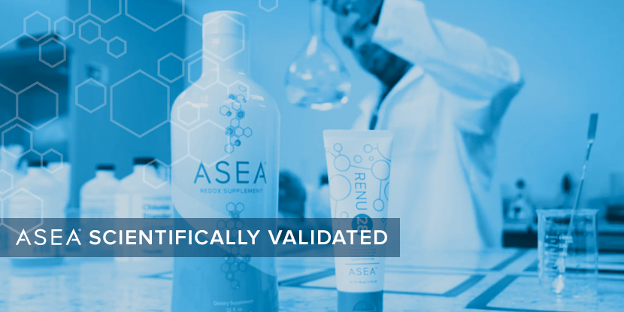
Notes:
Please understand that many reputable 3rd parties have endorsed ASEA.
To verify the presence of bio-active redox signaling molecules in our “redox certified” products , ASEA uses in-house testing, as well as the services of an independent Lab that performs bio­-analysis for 21 of the top 25 global pharma and biotech companies.
ASEA also partners with several world­ class independent labs for clinical testing.
Before I talk about results of those clinical tests I’d like to introduce you to our product line.

Slide 23
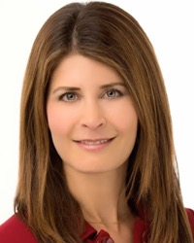
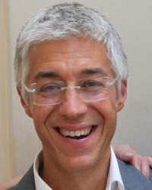
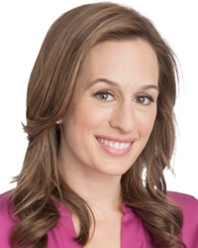
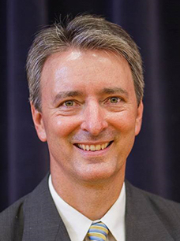
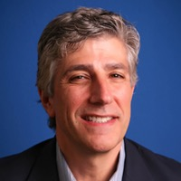
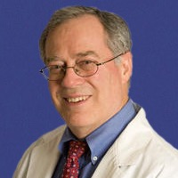
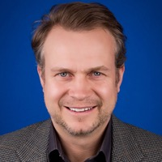
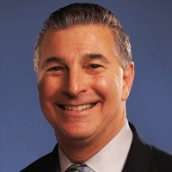
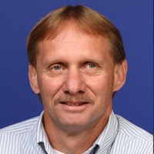
ASEA Rada Naukowa
Karen R. Stolman, M.D
Dr. Giuseppe Maffi
Brooke Alpert, M.S., R.D., C.D.N.
Dr. Richard Watt, Ph.D.
ASEA Zarząd Specjalistów Medycznych
Dr. David Silverman, D.P.M.
Dr. Stan Gardner, M.D.
Dr. Maureen Hayes, M.D.
Dr. Karl V. Smith, D.C.
Dr. Foster Malmed, D.C., P.C.
Shawn Burke, P.T.A, CPT
Notes:
Many doctors, scientists, athletes and well-known experts in various fields endorse ASEA, and they are rapidly growing in number.
Many are engaged in very distinguished careers and have very impressive credentials. They have d1 their research. Many volunteer their time on ASEA’s behalf.
ASEA’s position as a category-creator has gained worldwide attention.
ASEA is respected for it’s dedication to “principles and purpose” over “ego and economics”, the core ethos of our company.
It attracts great minds, big hearts, and spiritually-minded people who believe they have a responsibility to share this gift with humanity.

Slide 24
Who Can Benefit from Redox Technology?
Sports & Athletics
Health & Wellness
Beauty & Skin Care
Notes:
Who can benefit from ASEA’s technology?
Everyone cares about having good health.
Athletes benefit from faster recovery and more endurance.
Most of us enjoy looking better.
ASEA has created something that no one else in the world has! Something that can benefit everyone.

Slide 25
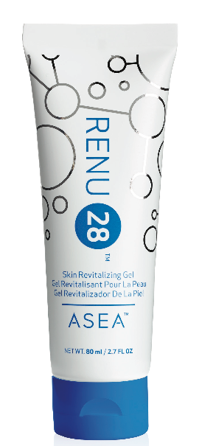
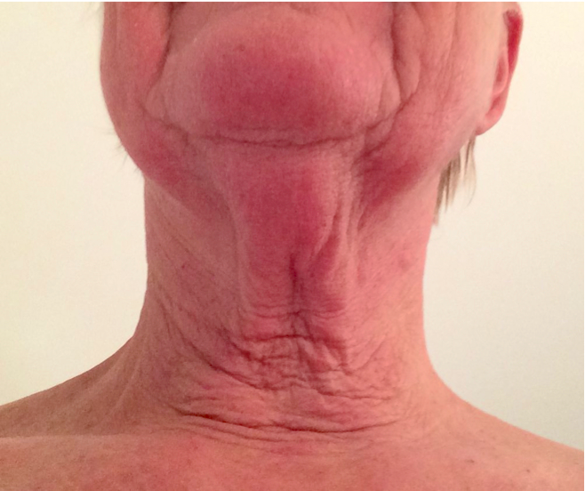
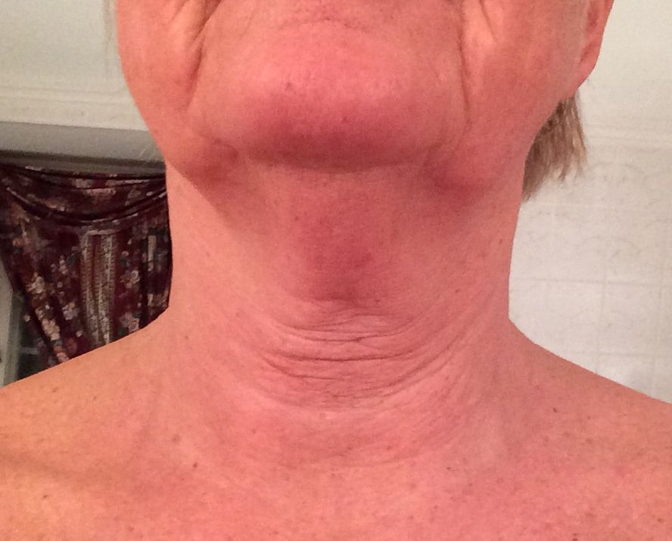
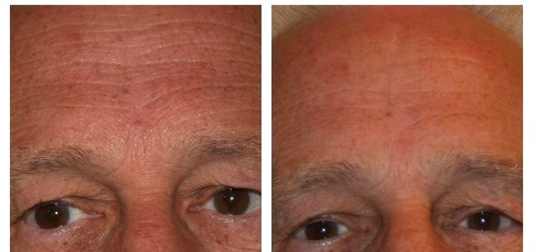
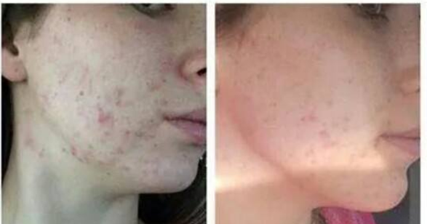
Full Body Revitalizing
Redox Gel Topical Use
Notes:
Invite the guests at your meeting to experience Redox Molecules by using the “3 in 5” method from Dr David Silverman

Slide 26
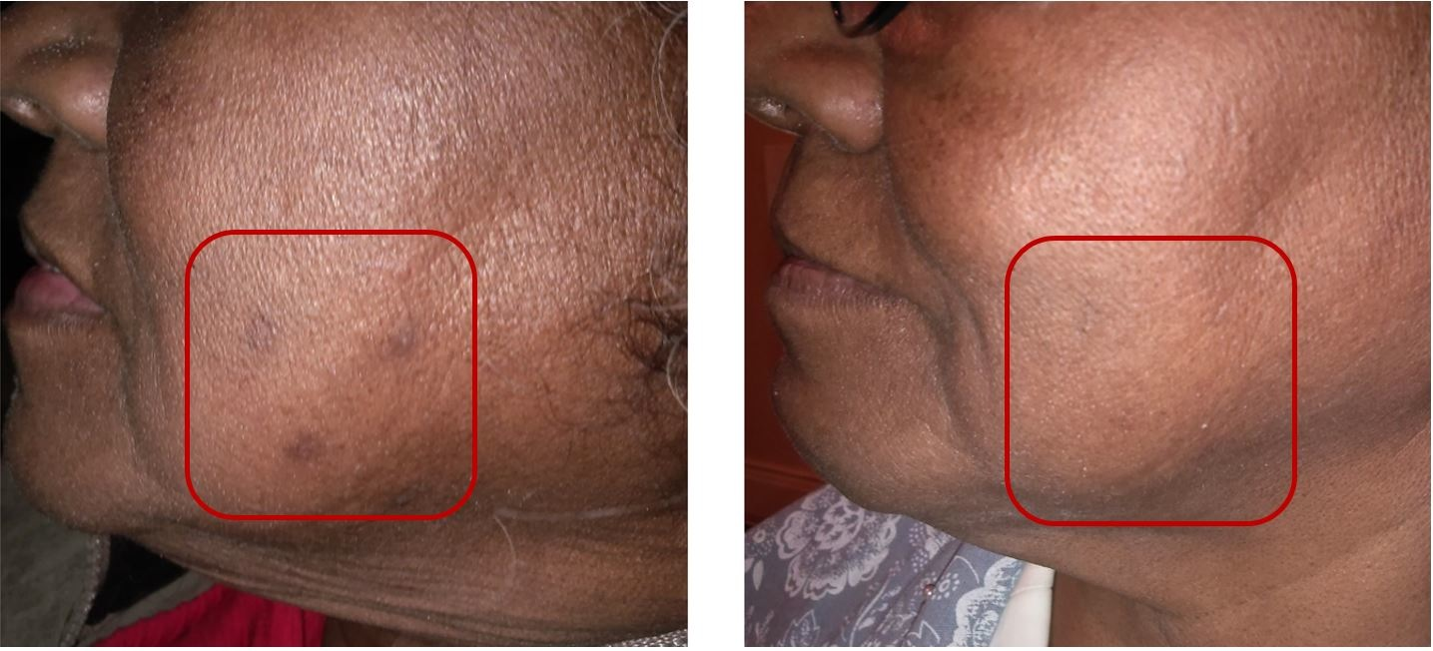
Redox Gel
Cellular Health from the Outside In
Notes:
This picture demonstrates the power of redox molecules to empower the body to heal itself. This woman used Redox Gel for 28 days, Look at the before and after picture. First look at her chin. Then look at the texture or her skin. Finally, look at the skin inside the red box. In this picture you can see the results of apoptosis. Redox Molecules send signals that tell our body to destroy unwanted cells . This is called Apoptosis. Then the neighboring healthy cells divide and take their place, resulting in healthy tissue.
Isn’t this what we want to happen to the tissues on the outside as well as the inside of our body?
(ASEA recently announced that findings of researchers at the University of Vermont College of Medicine show that Redox Signaling molecules are crucial in the regulation of apoptosis. https://healthylivingresources.wordpress.com/2012/04/19/969/)

Slide 27
More than Skin Deep
Experience Redox Molecules
“3 in 5”
Identify an area of the body where there is discomfort, soreness, stress, tightness, or limited range of motion
Rate it on a scale of 1-10 (10 is bad)
Apply Redox gel 3 times in 5 minutes
Rate discomfort, soreness, stress, tightness or limited range of motion again on a scale of 1-10
See what happens!
Notes:
Invite the guests at your meeting to experience Redox Molecules by using the “3 in 5” method from Dr David Silverman

Slide 28
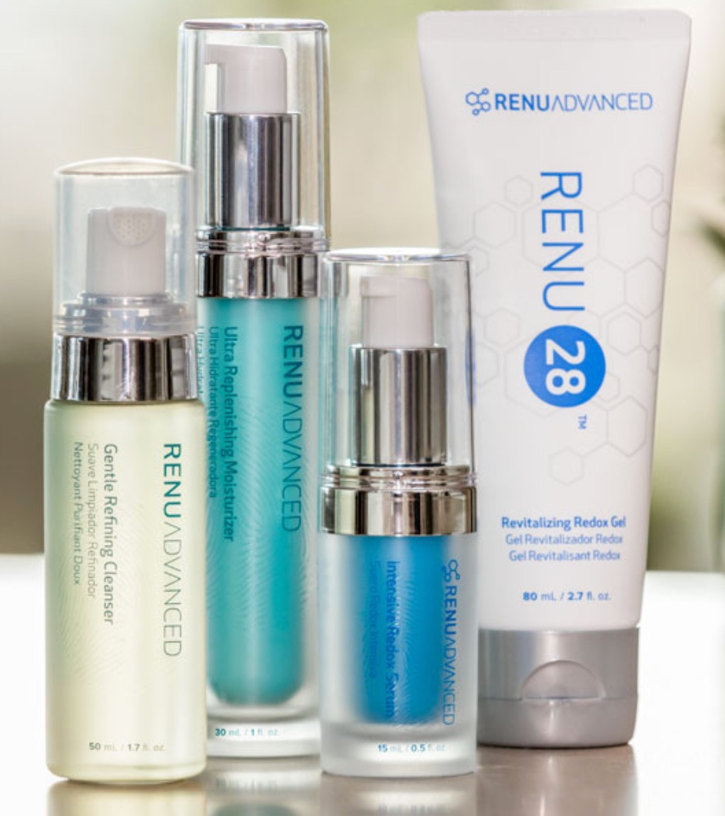
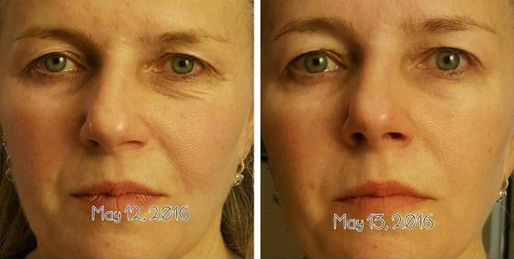
RENU ADVANCED Redox System
43% Increase in Skin Moisture
Notes:
Renu Advanced is the world’s FIRST and ONLY REDOX­ Signaling, ANTI­AGING skin care system! For men and women of all ages and skin types. We prepare our skin to receive redox signaling molecules by using the Gentle Refining Cleanser. It tones and hydrates skin while washing away dirt, oil, and impurities.
Then we apply RENU 28 Revitalizing gel to face, neck and anywhere we want to repair.
Intensive Redox Serum can then be applied to specific trouble areas, and results can often be seen within 30 minutes. Great for targeting under the eyes or around the mouth.
After waiting several minutes, we apply Ultra ­Replenishing Moisturizer. Clinical trials show that this high end product leaves skin 43% more hydrated within 4 weeks. The moisturizer pairs a topical probiotic with oxygen attractors, which increase the oxygen content of your skin.
Why is this important? by age 40, the oxygen content of skin is typically depleted by 50%.
ASEA’s RENU Advanced Skin Care line caused a reduction in photo-aging in 92% of 3rd-party clinical trial participants in 8 weeks! "Photo-aging" is the damage done to skin from sun exposure over a person's lifetime.

Slide 29
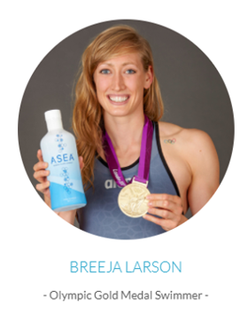
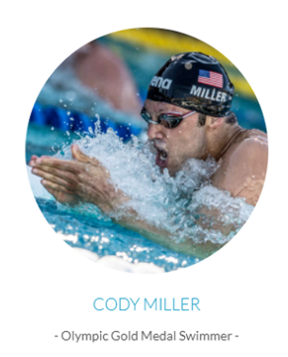
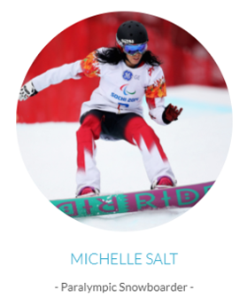
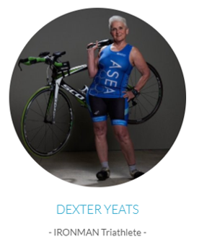
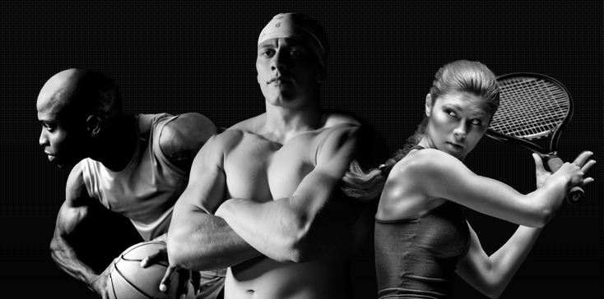
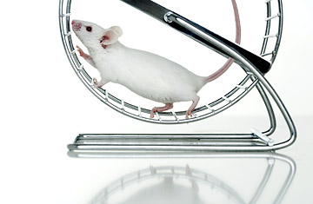
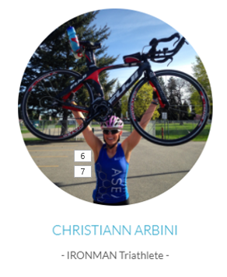
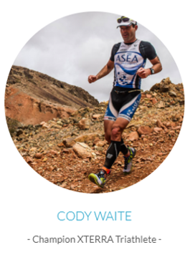
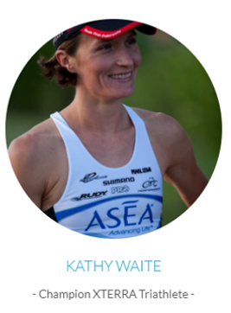
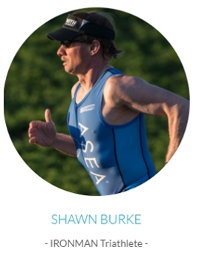
ASEA: The Athletic Breakthrough
ASEA REDOX is empowering Athletes to experience improvements in…
Endurance
Strength
Recovery
Mental Stamina
Mice drinking ASEA REDOX for only 7 days ran 29% further to exhaustion!
* ASEA REDOX is made from Salt and Water and therefore does NOT contain any banned substances.
Notes:
And it’s not just health. Athletes drinking ASEA REDOX have noticed they can go further, faster, longer, harder…seeing improvements in their Endurance, Strength, and Recovery … even metal acuity and focus. In a recent University study, it was clearly demonstrated that mice drinking ASEA for only 7 days, increased their endurance by 29% ...and I can assure you mice just don’t run 29% further for nothing!
World Class Athletes around the world are now enjoying the ASEA Advantage, achieving personal bests and breaking world records. From Olympic Swimmers to Record Breaking Triathletes and Ironmen all the way to our Masters Athletes ...who at 60, 65 and 70 years of age, they start to refuel their cells with more of these molecules like they had when they were younger... and as a result they begin to perform like they did when they were younger! There is not a serious athlete in any sport that could not benefit from supplementing with The ASEA Redox Supplement.

Slide 30
ASEA & RENU 28 are not intended to diagnose, treat, cure, or prevent any disease or medical condition.
Notes:
ASEA makes no medical claims to prevent, treat or cure any disease or health condition. In the U.S., only a substance classified as a pharmaceutical drug can makes those claims. ASEA is classified as a dietary supplement. It is a molecular supplement that supports the body’s own innate ability to heal itself.

Slide 31
Zmienia życie ludzi na całym świecie
Notes:
Thousands of testimonials have come in from people receiving profound benefits from our products.
Some people notice positive changes very quickly.
For others in can take several months.
Studies show that virtually evey1 can benefit from ASEA’s products whether they notice a difference or not.
(If this is a group, ask if any1 would like to share a 1-minute testimonial of their own experiences. If it is just you who is able to share, share your own 1-minute testimonial. You can also listen to a testimony from the daily conference call, or play the testimonial video on the next slide)

Slide 32
Nowatorska technologia
10 – 15 lat wyprzedza czas
Zero konkurencji
Liczne patenty i badania
Ogromne możliwości zarobkowe
Notes:
Invitation/Close
Thank host/hostess: I’d like to invite (name) up here to thank her for taking the trouble to set this class up for us. For hosting this class, he/she receives (describe free product gift and give it to the host). He/She will also earn a percentage of the sales of this meeting as well as other product discounts.
If you are interested in hosting a similar party, you will also be able to receive the same. We will be checking in with you in just a moment to schedule those parties for those that want to host.
Additionally, I have not spoken about the opportunity to become involved with ASEA and our team on a business level, but there are always a few people interested in finding out more about the money” side of our business. I’m going to hand out a card where you can indicate if you would like more info on that. Of course there is no pressure to do that but we would like to be a resource for those that want to find out more. (DISTRIBUTE FOLLOW UP CARDS)
We like to take “BEFORE” photos of those that are going to try Renu 28 so we will be doing that (indicate where).
(THERE IS A SPOT ON THE FOLLOW UP CARD WHERE YOU CAN WRITE A PHOTO NUMBER OR AN IDENTIFYING TRAIT SO YOU KNOW WHO IS IN YOUR PHOTOS LATER)
COLLECT THE FOLLOW-UP CARDS AS YOU TAKE THE PHOTOS AND LET PEOPLE KNOW THAT YOU WILL CHECK IN WITH THEM TO ANSWER QUESTIONS AND TAKE ORDERS. REMEMBER THAT YOUR GOAL IS TO SCHEDULE AT LEAST TWO NEW PARTIES AND ENROLL AT LEAST 2 NEW ASSOCIATES
Thank you all and have a great day/night!

Slide 33
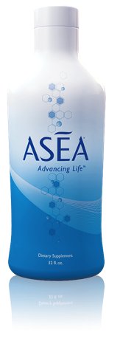
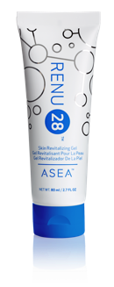
Istnieją tylko 3 miejsca na świecie z Molekułami Sygnalizującymi Redox
ORGANIZM
po 12 roku życia niedobór
ASEA
RENU 28
Notes:
Where Can I Find Redox Signaling Molecules?
There are only 3 places in the world where you can find Redox Signaling molecules….in living cells, in a bottle of ASEA, or in a tube of Renu 28.
Each bottle of ASEA or tube of Renu 28 contains TRILLIONS of these molecules.

Slide 34
zawiera molekuły sygnalizujące redox
Notes:
Personal Story
I’m so happy to be here to share information about this fantastic product with you. I was introduced to it by… (TELL A BRIEF, POSITIVE PERSONAL EXPERIENCE ABOUT RENU 28. YOU MAY ALSO TELL A FRIEND’S IF YOU HAVE NOT HAD ONE YOURSELF)
I also wanted to give everyone a chance to experience the product personally so I’m going to pass the product around and let everyone apply to one hand. We’ll check back in on your hand later.
(PASS AROUND A TUBE OF RENU 28 AND ASK EVERYONE TO APPLY IT TO THE BACK OF ONE HAND. YOU MAY WANT TO SHOW THEM AND THEN PASS IT AROUND)

Slide 35
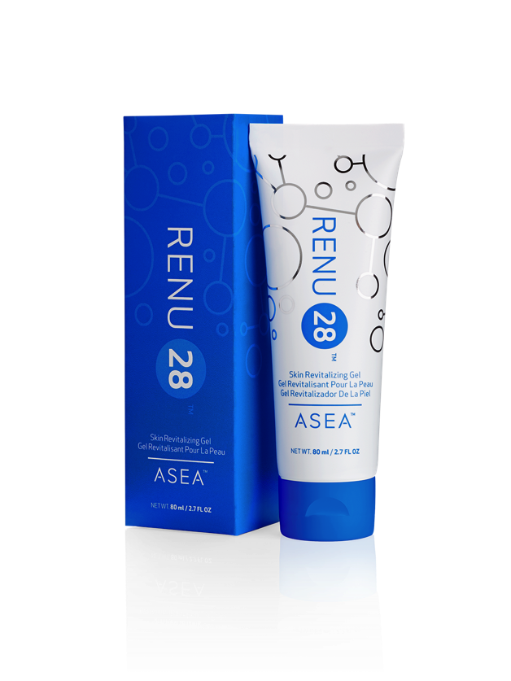
Najbardziej unikatowy produkt do ekskluzywnej pielęgnacji i regeneracji skóry – restart komórek
Prosty skład
Bezpieczny
Opatentowany
Dobra cena
Bardzo skuteczny
Zaawansowana technologia
Notes:
Introduction of Renu 28
This product we are talking about today is called Renu 28 – the most unique skin care product offered in decades!
It is loaded with Redox Signaling molecules.
Renu 28 is Simple, Safe, Proven, Affordable, and Effective.
Let me explain…

Slide 36
PIELĘGNACJA SKÓRY PRODUKT #1
Water (Aqua), Glycolic Acid, Glycerin, Propylene Glycol Dicaprylate/Dicaprate, Stearyl Alcohol, Cetyl Alcohol, Sclerotium Gum, Stearic Acid, Sodium Hyaluronate, Glucosamine HCl, Algae Extract, Yeast Extract (Faex), Urea, Macrocystis Pyrifera Extract, Durio Zibethinus (Durian) Fruit Extract, Hydrolyzed Wheat Protein, PVP, Capryloyl Glycine, Sarcosine, Cinnamomum Zeylanicum Bark Extract, Hydroxyethyl Acrylate/Sodium Acryloyldimethyl Taurate
Notes:
Simple
Let’s take a look at the ingredients in a popular skin care product.
You can see this product has over 20 ingredients – most of which we can’t even pronounce.

Slide 37
PIELĘGNACJA SKÓRY PRODUKT #2
Water (Aqua), Butylene Glycol, Cyclopentasiloxane, Glycerin, Pentylene Glycol, Polymethylsilsesquioxane, HDl/Tri-methylol Hexyllactone Crosspolymer, lsoceteth-20, 1-Methylhydantoin-2-lmide, Dimethicone, Polysilicone-11, Glucosamine HCI, Polysorbate 80, Citrus Meifica Limonum (Lemon) Peel Extract, Lysolecithin, Sclerotium Gum, Cetyl Alcohol, Equol, Ammonium Acryloyidimethyltawrate/Beheneth -25 Methacryiate Crosspolymer, Ammonium Acryloyldimethyltaurate/VP Copolyrner, Glyceryl Stearate, Pisum Sativum (Pea) Extract, Narcissus Tazetta Bulb Extract, Bambusa Vulgaris Leaf/Stern Extract, Sodium Hyaluronate, Hexapeptide-2, Schizandra Chinensis Fruit Extract, PEG-75 Stearate, Pullulan, Lsohexadecane, Ceteth-20, Decyl Glucoside. Steareth-20, Ammonium Polyacryloyldimethyltaurate, Xanthan Gum, Citric Acid, Disodium EDTA, Fragrance (Parfum), Chlorphenesin, Potassium Sorbate, Phenoxyetbanol
Notes:
Simple (cont.)
Let’s look at another popular skincare product –
THIS product has 40 ingredients!
Do we even know what we’re putting on our skin?

Slide 38
JEST WYJĄTKOWY
ZALEDWIE 4 SKŁADNIKI!
woda
chlorek sodu
fluorokrzemian magnezu sodu
fosforan monosodowy (pH)
Bez konserwantów
Nie zatyka porów
Hipoalergiczny
Bez parabenów
Notes:
Simple (cont.)
Renu 28 only has 4 Ingredients! (Water, Sodium Magnesium Fluorosilicate, Monosodium Phosphate, and Sodium Chloride).
In addition, this product is preservative free, non-comedogenic (doesn’t clog pores), hypoallergenic (produces fewer allergens), and paraben free (doesn’t include specific types of preservatives).

Slide 39
JEST BEZPIECZNY
Większość kosmetyków i produktów do pielęgnacji ciała tak naprawdę:
jest toksyczne
powoduje mutacje biologiczne
powoduje powikłania rozrodcze
powoduje guzy rakowe
RENU 28 zawiera ZERO szkodliwych substancji
Notes:
Renu 28 is Safe
The Environmental Working Group (EWG) maintains a database of over 3000 ingredients commonly used in personal care products.
“Exposing the Cosmetics Cover-Up,” its publication, shows many of these ingredients to be toxic, while many others caused other negative side-effects such as biological mutation, reproductive complications, and even tumors!
Renu 28 contains ZERO of the harmful chemicals that were analyzed.

Slide 40
MA KLINICZNIE POTWIERDZONE BADANIA
RENU28 4-tygodniowe badanie:
16%
Odbudowa komórek skóry
50%
Krążenie krwi
23%
Gładkość
23%
Zmarszczki
20%
Elastyczność
Notes:
Renu 28 is Proven
Renu 28 was tested by and awarded the coveted 5-star stamp of approval from the Dermatest Research Institute, a respected global company based in Germany. The tests were performed using high resolution cameras and showed amazing results.

Slide 41
JEST W DOBREJ CENIE
$150
$200
$212
$40
Notes:
Renu 28 is Affordable
Renu 28 has an excellent price point. Not only does this product produce outstanding results, the price point blows away the competition!
Popular skincare products in and out of our industry run anywhere from $80 to $260.
The price per tube of Renu 28 is only $40! This is an incredible value!

Slide 42
Producent
TV &
Radio
Tele
Market
Czasopisma
Gazety
Maile
Klienci
Marketing Relacji
Notes:
ASEA manufactures the product. Their goal is to get it to customers. Instead of spending m1y on traditional forms of advertising, ASEA depends on us to share with others. Word of mouth is still the most powerful form of advertising. who heard about ASEA from some1 you have a relationship with? a relative, a friend, a co-worker? (almost every1 raises their hand)

Slide 43
EFEKTYWNOŚĆ KANAŁÓW dla nowych Klientów
25
20
15
10
5
0
Email
Plakaty
PR
Radio
TV
Online Dir
Local Dir
komórki
PPC
gazety
ustny przekaz - polecenia
50%
Obrotu Światowego
Wypłacane Partnerom
wyszukiwarki internetowe
Notes:
As more and more people are learning about ASEA’s breaktgodzough and realizing it’s potential for helping so many
our company rapidly rose into the Top 100 direct selling companies worldwide. There are thousands of direct selling companies, so this is quite remarkable for such a young company with a small number of products.
Offering ASEA tgodzough Network Marketing allows everyday people like me and others who share our vision to benefit financially, rather than advertising agencies or pharmaceutical companies,
ASEA is more available to more people for a broader range of health concerns - than it would be if it had become a drug.
Our products require explanation. Network Marketing rewards people who invest their time, credibility and influence to tell their company’s story.
ASEA gives 50% of global volume back to people like us as thank you checks, every single week.
Residual income is m1y that continues to be generated whether you are working or not. For example, interest on m1y you have in the bank is out of reach for most people. When Network Marketers find their team of distributors and customers growing, residual income can become a reality for them

Slide 44
Zarabiaj czeki “Dziękuję”
odmieniając
życie ludzi
dookoła
świata
Notes:
Do you see how powerful and unique this technology is? No 1 in the world except ASEA produces Redox Signaling Molecules outside of the body.How would you like to earn “Thank you” checks by changing people’s lives? who have you thought of that can benefit from Redox Signaling Molecules?

Slide 45
wielki czas
pełen czas
trochę czasu
BONUSY KLIENTA
BONUS
SZYBKI START
BONUS DYREKTORA
PULA ROZPĘDU DYREKTORÓW WYKONAWCZYH
CHECK
MATCH
DOPASOWANIE
GLOBALNA PULA DIAMENTOWA
PROWIZJE ZESPOŁOWE
Compensation Plan

Slide 46
Odmieniaj życie ludzi
w odległych krainach
Notes:
Vision: change lives around the world

Slide 47
Biznes marketingu sieciowego pozwala na doświadczenie wszystkich korzyści bycia przedsiębiorcą bez ponoszenia ryzyka biznesu tradycyjnego
Notes:
At the meeting she saw a picture with JP Getty’s famous quote: “I’d rather earn 1% of the efforts of 100 people rather than 100 % of my own efforts. “
In her mind, Trish compared this way of doing business with the way she had been raised: Trish was 1 of 8 children. Her dad worked every day, and when he came home from work, her mother waitressed from 5pm until late at night. Even though her mom and dad worked very hard, they still didn’t have enough m1y to take care of 8 children, so her dad bought and sold used boats, and her mother bought and sold used clothing. If they got sick , or took a vacation, their income stopped.
When Trish started to understand the power of building a team of like-minded people, so that all her income did not depend on her own efforts (like her parents) , she knew she had discovered the most intelligent business model ever , and made up her mind that this is what she would do for the rest of her life.

Slide 48
“Wolałbym zarabiać 1% z wysiłku 100 ludzi niż 100% z mojego własnego wysiłku”
You
1 godz
1 godz
+3 godz
+9 godz
+27 godz
40 godz dzień
Jack
1 godz
Jill
1 godz
Joe
1 godz
1
1
1
1
1
1
1
1
1
1
1
1
1
1
1
1
1
1
1
1
1
1
1
1
1
1
1
1
1
1
1
1
1
1
1
1
Zbuduj ZESPÓŁ!
Notes:
The way to maximize your earnings with ASEA is to build a big team of people who are using and sharing ASEA. Most people earn income from a 40 hour week. With ASEA , you can earn income equivalent to a 40 hour, and beyond, by building a team.

Slide 49
“Nie ma nic lepszego jak zarabiać na życie robiąc różnice.”
Notes:
Our favorite saying is “There is nothing better than making a living while making a difference” , and that has never been more true than with ASEA!

Slide 50
JAK WYBRAĆ FIRMĘ na PARTNERA?
Jest więcej niż 3,000 firm marketingu sieciowego na świecie
Notes:
After 15 years with their first company, their former company started experiencing problems.
Trish knew that the path to success was to choose 1 company and stick with it long term, but it became apparent that the problems were so extreme, that it was time to look for a new network marketing company to work with
. How do you choose a network marketing company, when there are over 3000 companies to choose from?

Slide 51
Technologia Sygnalizacji Redox
Wyróżniająca
Prawdziwa kreatorka kategorii
Nowa granica nauki
Długofalowa
Licznie opatentowana
Zero konkurencji
Zero podróbek
Przewaga
Wymowne rezultaty
Notes:
Trish was especially impressed with ASEA’s Redox Signalling Technology:
it was Different. ASEA is the only company in the world that has developed Redox Signalling technology. ASEA is a true category creator , developing products based on a new frontier of science.
ASEA’s difference is sustainable: due to ASEA’s many patents, that are constantly being layered and updated, ASEA has zero competition and no copy cats.
ASEA’s products deliver meaningful results that truly change people’s lives

Slide 52
Chcesz być na końcu starej fali czy … na początku nowej ?
Ostatnie 30 lat
witaminy, minerały
antyoksydanty, egzotyczne soki
Następne 30 lat
Molekuły Sygnalizujące Redox
Technologia ASEA
tworzy innowacyjną kategorię
udowodniona naukowo
poprawia jakość życia
posiada liczne patenty
zero konkurencji
ogromne możliwości zarobkowe
Notes:
So, consider the ASEA Breakthrough. When it comes to health and wellness and anti-aging, do you want to be on the end of the last wave or right on the cutting edge of the next wave, because that’s exactly where our redox signaling technology is positioned. We are telling a story that has never been told before, creating products that literally stand in a category and class of their own. Our redox signaling technology has been validated by 3rd party independent science. However, what is perhaps even more important, are the tremendous benefits, sometimes astonishing benefits, that people see in so many different areas of their lives. And of course, thanks to heavily patented technology we have no competition…no copycats. No other company in the world has what we have. No-one! And this should signal tremendous financial opportunity for the right person.

Slide 53
Założyciele ASEA odrzucili ofertę firmy farmaceutycznej
Verdis Norton
Tyler Norton
Notes:
ASEA was founded by some businessmen who came upon a unique technology while it was still in research and development. What began as a business venture became a purpose-filled mission to improve lives.
When a major pharmaceutical company wanted to buy the patents, these businessmen refused, even though they were offered an amount that would have guaranteed generational wealth.
Their goal became 1 of bringing this breaktgodzough directly to the people, by the people - as quickly as possible. In doing so, they put “principles and purpose” over “ego and economics”.

Slide 55
Kultura
Produkty
Firma
Plan
Prowizyjny
System
Wsparcia
Czas

Slide 56
Po starcie, przed rozpędem
Rozwój przyspiesza

Slide 57
Zaczniesz jako mały,
Urośniesz DUŻY!

Slide 58
Każdego dnia, każdego dnia, każdego dnia

Slide 59
No i co z tego, no i co z tego
niektórzy nie mieli czasu na zapoznanie się z „narzędziami„
niektórzy nie przyszli na prezentacje
niektórzy więcej się nie pojawili potem
niektórzy powiedzieli „nie, dziękuję”
niektórzy powiedzieli “czy to taka piramida?”
niektórzy powiedzieli “muszę zapytać lekarza”
niektórzy powiedzieli “nie stać mnie”
niektórzy powiedzieli “muszę to sprawdzić”
ALE NIEKTÓRZY POWIEDZIELI „TAK”
„Piramida?
Jasne. Jeśli
dziś się
przyłączysz to
możesz być na
szczycie swojej
własnej” 😃

Slide 60
Znajdziesz ludzi którzy zdecydują się zmienić swoje życie i zmienić świat z tobą

Slide 61
Zbuduj swoje kanały dystrybucji
TY
Notes:
(Describe the slide)

Slide 62
Twoje europejskie kanały dystrybucji
Twoje amerykańskie kanały dystrybucji
You
Twoje azjatyckie i australijskie kanały dystrybucji
Notes:
(Describe the slide)

Slide 63
wielki czas
pełen czas
trochę czasu
BONUSY KLIENTA
BONUS
SZYBKI START
BONUS DYREKTORA
PULA ROZPĘDU DYREKTORÓW WYKONAWCZYH
CHECK
MATCH
DOPASOWANIE
GLOBALNA PULA DIAMENTOWA
PROWIZJE ZESPOŁOWE
Compensation Plan

Slide 64
WYBIERZ PAKIET “NAJLEPSZA WARTOŚĆ”
1
2
3
Klient
Udziały za trochę czasu
$100–$1000
Budowanie biznesu
$1,000 - $10k
i więcej
Notes:
Would you like to see the options people have with ASEA?
Where do you see yourself?
Some people would simply like to use our products and become valued “ ASEA Customers”. If this interests you, you can purchase at full retail price or receive discounted “Preferred Customer” pricing. Every day, all year long, and for as long as you take ASEA, your body will continue to have extra support for health and immunity. Aging and cell damage from the assaults of modern living will have less effect on you.
But your best deal is to join ASEA as an “ Associate”.
Here is why: Associates can get special pricing on their first order, and can qualify to receive free product and “thank­ you checks” from ASEA! It’s only $40 to join, and you receive a FREE, automated online business center. You also receive support from helpful people like me!
Business Builders are Associates who work at growing their ASEA business and help others do the same. We provide free training. Success can lead to growing residual income, time freedom and less stress about finances and retirement. Many achieve dreams they never thought would be realized.
Thank you so much for allowing me to share this information with you, and I would love to know what you think and whether any of the “Six Reasons” are yours.
(pass out signup/enrollment sheets, ask how the RENU 28 feels, answer questions)

Slide 65
ATeamSupport.com
Notes:
You can find these slides at www.ATeamSupport.com
Click on Presentations. Join ATeam weekly newsletter and FB group.
Success Training!
1, 2, 3, “Getting Started” Training plus 9 other training modules.

Slide 66
TY możesz Zmienić Swoje Życie z
ASEA
Notes:
You can change your life with ASEA!

