Slide 1
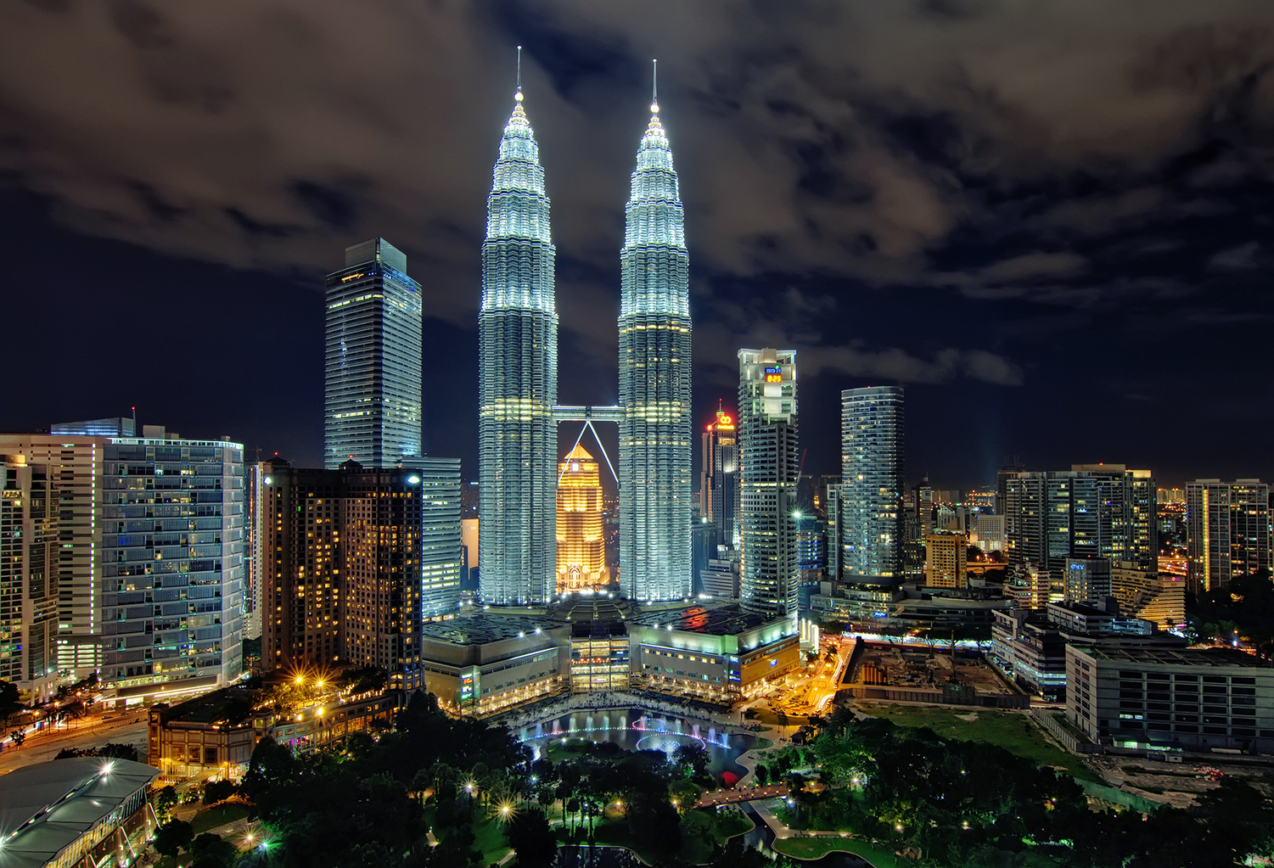
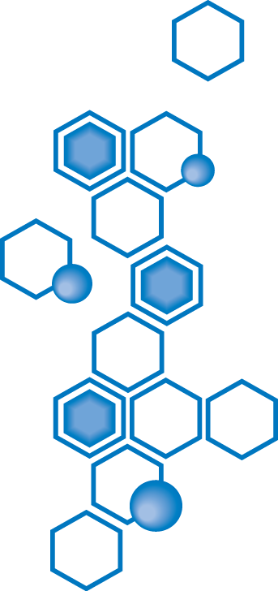
Selamat Datang
Welcome
歡迎

Slide 2
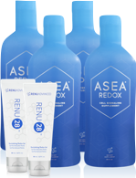
ASEA Malaysia Prelaunch

Slide 3
NEWEST
ASEA Market: Malaysia!!
最新的ASEA市場: 馬來西亞
Malaysia: 4th largest market in Asia
馬來西亞：亞洲第四大市場
Malaysia: Top 10 market Globally
馬來西亞：全球前10名

Slide 4
Malaysia Opening 馬來西亞開幕
ASEA has been working behind the scenes for 18 months to prepare Malaysia! ASEA一直在幕後工作18個月，為馬來西亞做好準備！
ASEA products fully registered : ASEA, Renu28, Renu Advanced and ASEA mlm is registered. ASEA產品註冊：ASEA、28凝膠、水美漾系列、直銷認證
Will ship products from warehouse within Malaysia 會將產品直接在馬來西亞從倉庫寄出到你家
Complete business Opportunity (no NFR)
Diamond Founder Program

Slide 5
Malaysia Opening
Sept. 2019 was Malaysia Pre-launch 試營運
Working towards Grand Opening 籌備開幕典禮
Future Malaysia office 未來將在馬來西亞設置辦公室

Slide 6
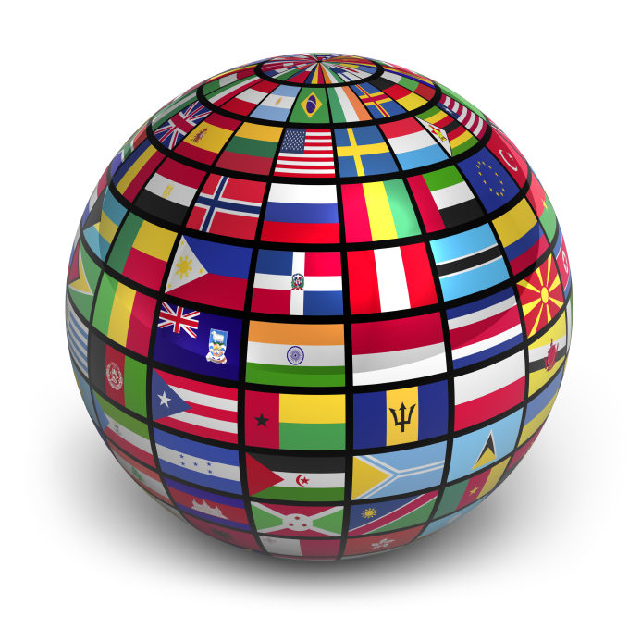
Feel Better 感覺更好
Perform Better 表現更好
Look Better 看來更好
Live Better 活得更好
Notes:
People are hearing about and are excited about our company for many reasons. One reason is that it is DIFFERENT! ASEA is the only company in the world that has developed ​Redox Signaling technology​.
In the fields of health, anti-aging, and athletics, ASEA is a true ​category creator,​ developing products based on a new frontier of science.
And this difference is​ sustainable.​ Because of ASEA’s many patents, that are constantly being layered and updated, ASEA has zero competition and NO copycats!
People in ASEA are inspired and purpose-driven because our products deliver powerful results that truly change people’s lives!

Slide 7
ASEA Mission: 安司雅宗旨
To better people’s lives and to be a force for good in the world. 提昇世人的生活，成為世上一股向善的力量.
35 Countries & Expanding:
35個國家，且不斷地在擴展中：
North America, Europe, Australia/New Zealand, Asia 北美,歐洲, 澳洲/紐西蘭, 亞洲
Cumulative Sales Volume: $650 million 銷售總額：六億五千萬美元
Launched 2010 2010 年開始運作，
Profitable year 1 一年即獲利
Debt Free / Privately held 無債/私有
Notes:
ASEA’s Mission is “to better people’s lives and to be a force for good in the world”.
Launched in 2010 with just ONE product, ASEA has expanded to over 30 countries by word of mouth! A great testament to the product’s results and unique nature - don’t you think?

Slide 8
Revenue Curve Shows
Increasing Demand
for ASEA

Slide 9
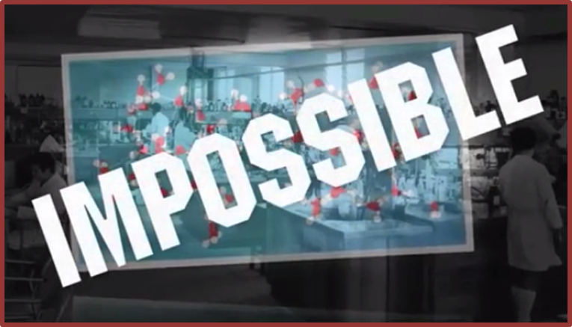
10-15 Years Ahead of Its Time
突破：”我們這一代最偉大的健康科學”
Cutting Edge Technology
New Category of Science
Notes:
In this short video I will introduce you to a breakthrough technology called ASEA ...that is 10-15 years ahead of its time and is a cutting edge technology that represents an entirely new category of health science. At one time Science had declared that this breakthrough was impossible and yet today many experts are recognizing as one of the most significant health and anti-aging breakthroughs of our lifetime.

Slide 10
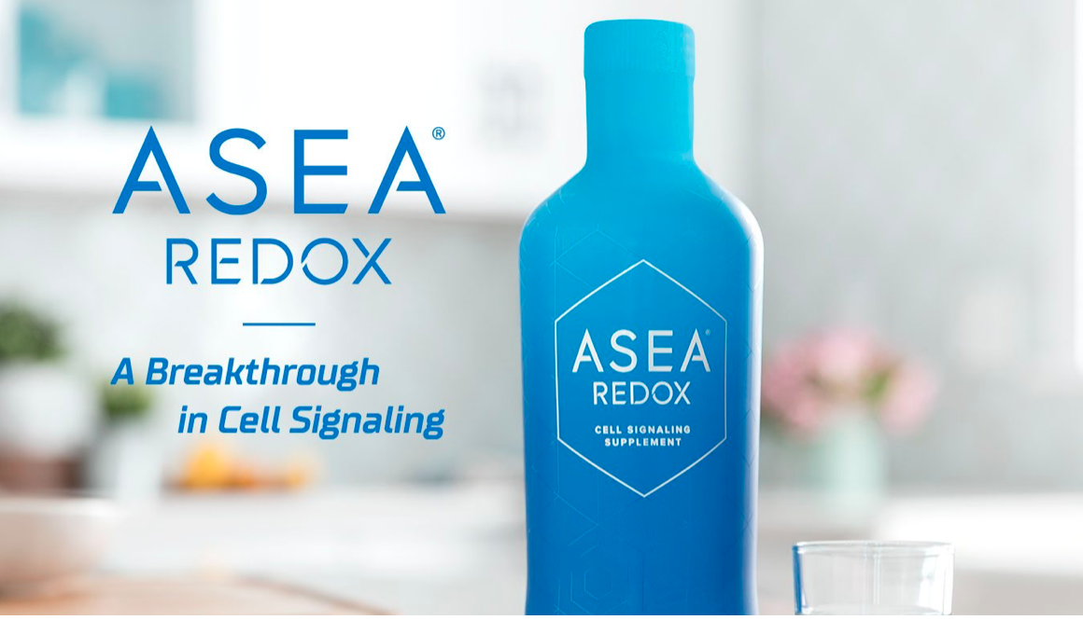
ASEA Redox is a Cell Signaling Supplement
氧化還原信號科技
ASEA REDOX
Flagship Cellular Health
Technology
Notes:
By seeing and feeling results with the Redox Gel, you can begin to understand the transformative power of Redox Molecules! What could happen to the inside the body when consuming the same Redox Molecules in supplement form?

Slide 11
Redox Signaling Technology 氧化還原信號科技
Different
True Category Creator
New Frontier of Science
Sustainable
Heavily Patented
No Competition
No Copy Cats
Advantage
Meaningful Results
Premier Business Opportunity
Notes:
Trish was especially impressed with ASEA’s Redox Signalling Technology:
it was Different. ASEA is the only company in the world that has developed Redox Signalling technology. ASEA is a true category creator , developing products based on a new frontier of science.
ASEA’s difference is sustainable: due to ASEA’s many patents, that are constantly being layered and updated, ASEA has zero competition and no copy cats.
ASEA’s products deliver meaningful results that truly change people’s lives

Slide 12
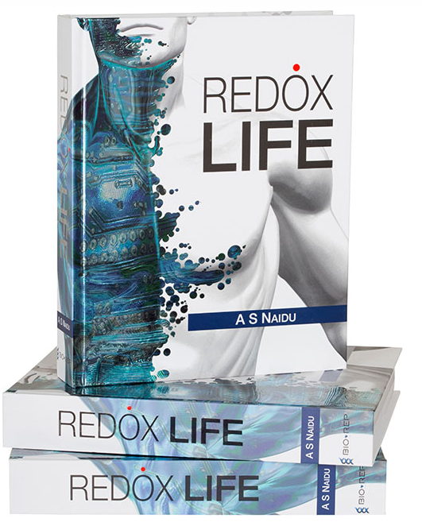
The Redox Discovery
Redox Signaling Molecules are Native to your Body
Energy
The Cell
(salt water) 細胞生化學源自鹽水中
Over 15,000 peer review articles and 1,200 books published.
超過15,000篇研究氧化還原信號的報導發表在 科學及醫學暢銷期刊
Redox Signaling Molecules
are involved in virtually every major body system and function.
}
Redox Signaling Molecules 氧化還原信號科技
Key to Cellular Rejuvenation and Renewal
氧化還原信號分子 是由體內每一個細胞內的鹽水所產生的，對生命至關重要。
Notes:
Here is a little about the SCIENCE behind ASEA:
Redox Signaling Molecules are native to our body. They are made from the salt water found inside our cells.
The molecules were once thought to be useless by-products of cell metabolism.
But now: there are over 15 thousand peer-reviewed articles and 12 hundred books exploring ways that Redox Signaling Molecules are critical to every major body system.

Slide 13
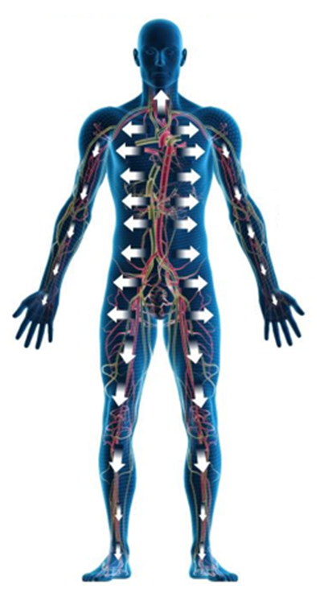
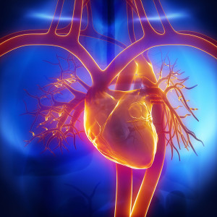
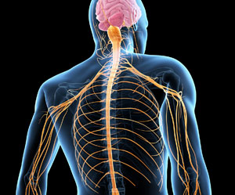
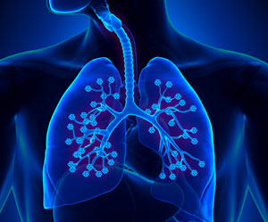
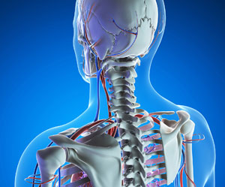
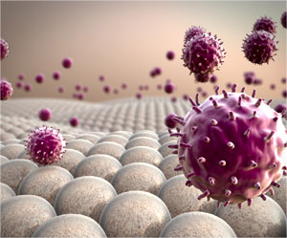
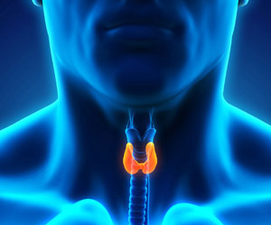
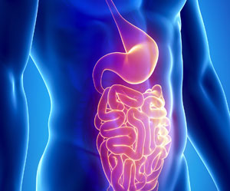
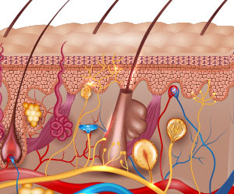
Redox signaling molecules are used in the regulation of the 12 major systems of the body:
Skeletal, Digestive, Respiratory, Circulatory, Muscular, Urinary, Reproductive, Endocrine, Nervous, Immune, Lymphatic, Integumentary
Redox Signal molecules
strengthen the body's own healing process
罹患疾病因素顯著降低

Slide 14
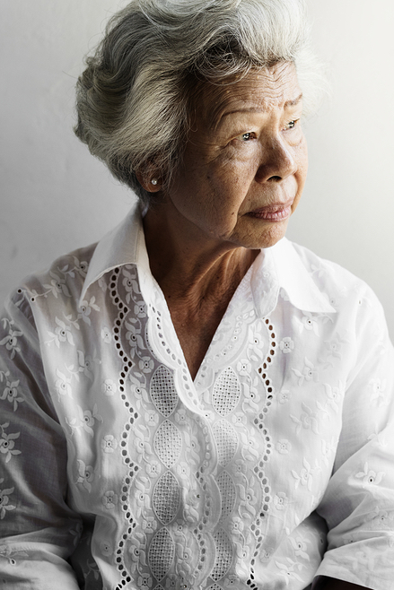
Age, Pollution, Poor Diet, Stress
隨著年齡增長，飲食不當及生活壓力，我們的細胞減緩活力
Deficiencies and Imbalances in Redox Function 氧化還原功能不足和失衡
Notes:
• 随着年龄越大，我们产生的氧化还原信号分子就越少。由于当身体有问题时，需要氧化还原信号分子发出信号。没有足够的氧化还原信号分子，就像是我们的细胞要播119却没有好的信号。因此结果就是，比起年轻时，我们现在出现更多慢性健康问题。
• 我们的视力减弱，记忆力大不如前，关节开始疼痛。我们的免疫系统变弱或过度反应。原来灵活的身体，似乎少了些以往的灵活。
• 许多人认为这些问题不可避免，或只是老化的一部分。但研究发现，这其实是氧化还原功能不足或失衡的结果。

Slide 15
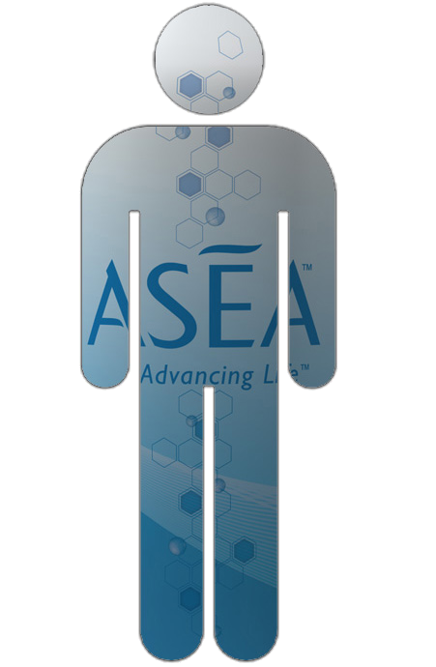
Notes:
Many people assume these issues are inevitable or just a part of aging. But researchers now understand that many are the result of deficiencies and imbalances in Redox function.
What if there were a way to replenish these molecules... so that we could start to feel and look the way we did 5-10-15-20 years ago??

Slide 16
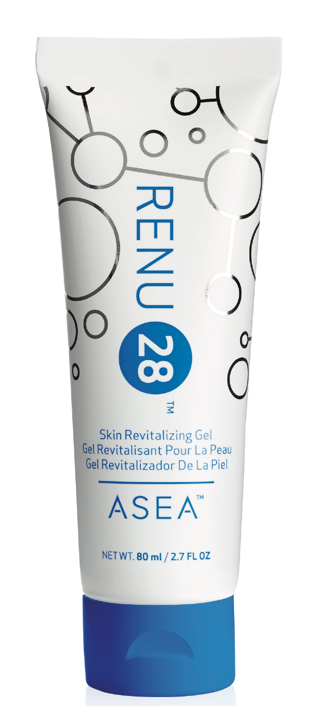
One Company has harnessed
the Power
of
Redox Molecules
一家公司利用
的 功率
的 氧化還原 分子
Notes:
ONE company was able to harness the power of Redox Signaling Molecules. They’ve created products that provide astounding health and anti-aging benefits to people all over the world.

Slide 17
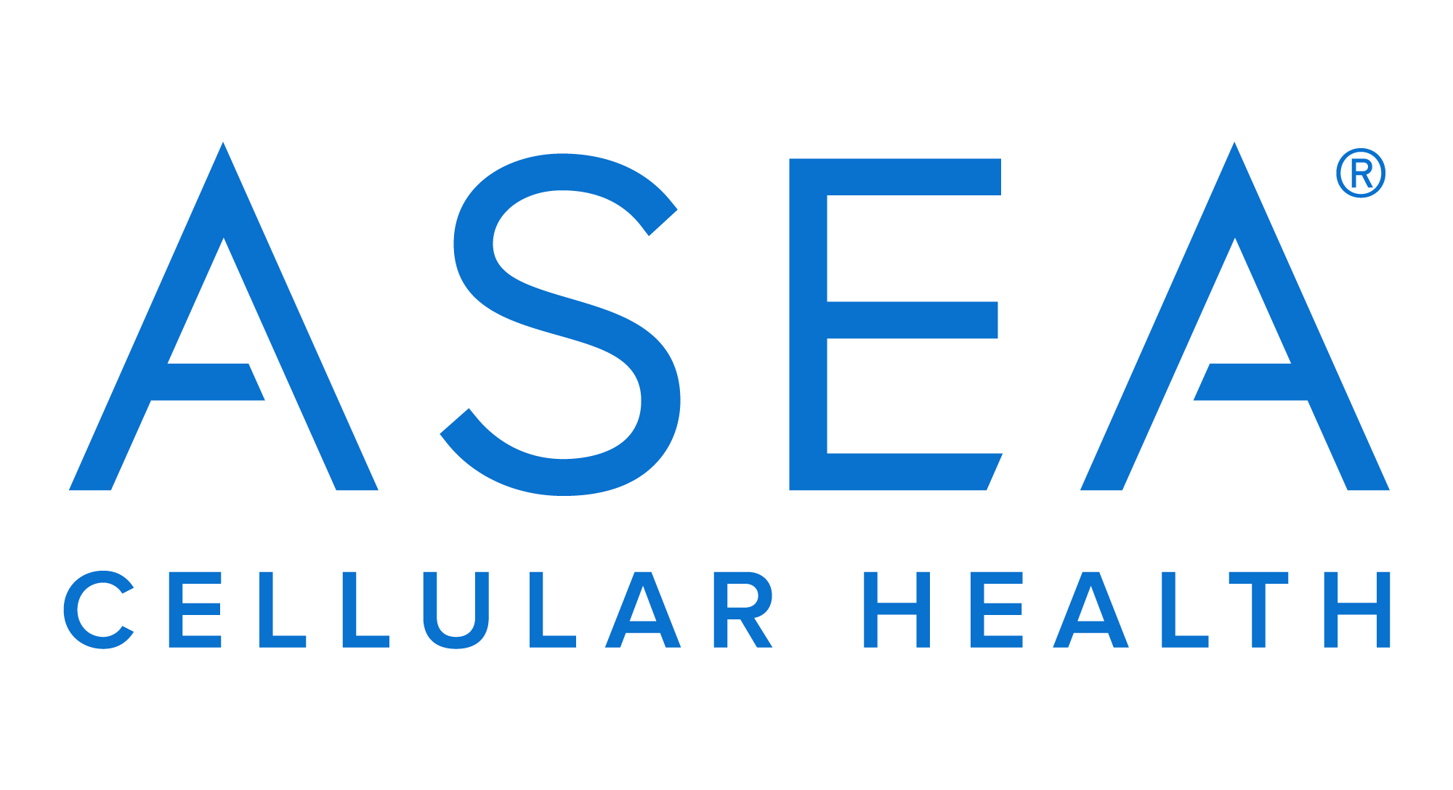
Notes:
That company is ASEA. This patented technology is a revolutionary breakthrough.
Many consider it not just a health science breakthrough, but a GIFT for humanity... at a time when we have an ​unprecedented ​amount of cell-damaging toxins in our environment.

Slide 18
ASEA Redox Breakthrough
氧化還原大突破
After extensive research, laboratory testing, and millions of dollars, a team of scientists achieved the impossible.
通過廣泛研究，實驗室測試，
一組 科學家完成了不可能的壯舉
They stabilized Redox Signaling Molecules outside of the body in perfect balance as they are found in healthy cells. 他們在體外穏住氧化還原信號分子
其完美平衡一如體內健康的細胞。
Notes:
After years of research, testing, and investing millions of dollars, a team of scientists achieved something incredible.
They created actual Redox Signaling Molecules. The first and only source for them outside the body. And they stabilized them so that they can be stored and consumed as a supplement. Trillions in one bottle. In the same perfect balance found in healthy cells.
They were bioactive - and ready to get to work!

Slide 19
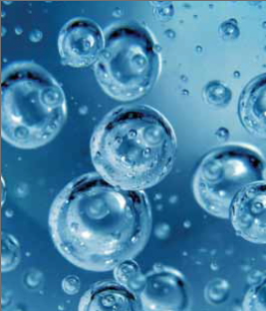
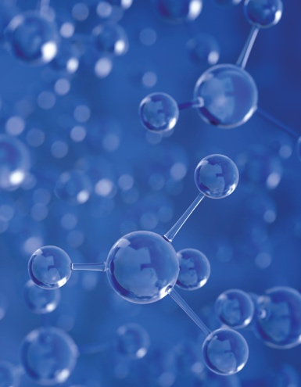
ASEA’s Patented 3 Step Process ASEA 專利三步曲
Step 1
Pristine saltwater
(same as found inside your cells)
Step 2
Saltwater broken down into free floating atoms
NA-Cl-H-O
Step 3
Atoms restructured into STABILIZED Redox Signaling Molecules
第一步 鹽水
（與您細胞内的鹽水相同)
第三步 原子重組為 穩定的氧化還原信號 分子
第二步 鹽水分解成自由 浮動的原子 鈉-氯-氫-氧
Notes:
ASEA starts with 2 simple ingredients: pure water and salt. Why?
Because when our cells make Redox Molecules, they use water and salt. Resources they have in abundance. ASEA replicates the body’s natural process.
The water and salt molecules are broken into free-floating atoms. Then restructured into two categories of perfectly balanced Redox Molecules.
After this process is complete, only a little salt remains. One serving of ASEA contains about as much sodium as a carrot. So even those on a salt restricted diet can find room to include ASEA.

Slide 20
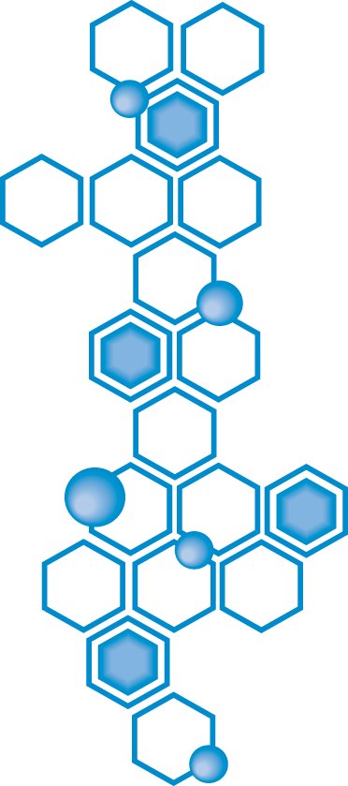
Redox Molecules made from
“water & salt”,
just the way our cells make them.
Notes:
Why does the ingredients label on ASEA say water and salt? Because those are the ingredients that are used to make Redox Molecules. Just as flour and water are used to make bread.

Slide 21
Who Can Benefit from Redox Technology?
誰是ASEA 高科技的受益者？
Sports & Athletics
運動及體能
Health & Wellness
健康與保健
Beauty & Skin Care
美容和皮膚護理
Notes:
Everyone​ cares about feeling good, about having good health and less discomfort.
Everyone​ benefits from faster recovery and more endurance. Especially athletes!
And ​most​ of us enjoy looking better and having healthy skin!
ASEA has created something incredible that can benefit everyone and that no one else in the world offers.

Slide 22
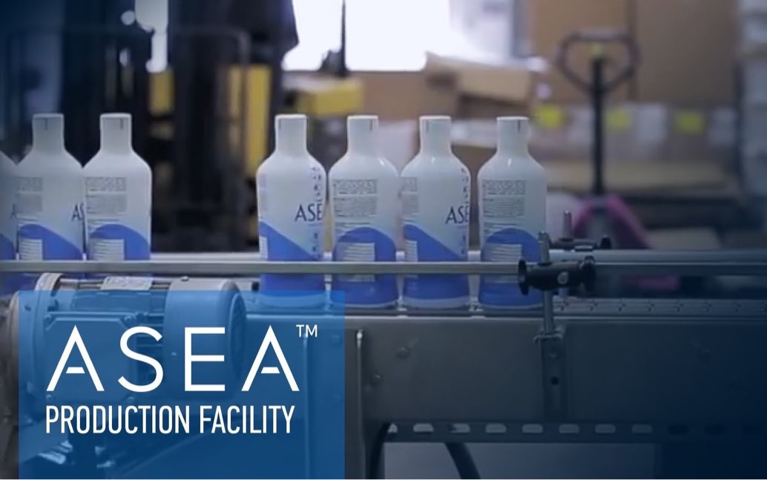
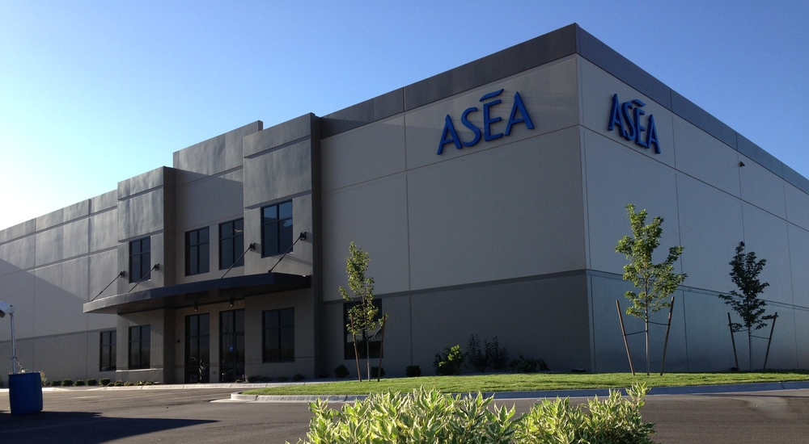
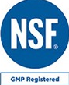
NSF Certified, GMP 美國國家科學基金會認証
FDA Registered, Kosher * 聯邦食品藥物管理局註冊
ASEA Manufacturing Plant 安司雅 製造工廠.
Pleasant Grove UT USA 美國猶他州
Notes:
The one-of-a-kind, in-house manufacturing plant is located in Pleasant Grove, Utah. It’s an FDA Registered and NSF Certified facility. ​
NSF is ​an accredited third-party certification body that tests and certifies products to verify they meet public health and safety standards.

Slide 23
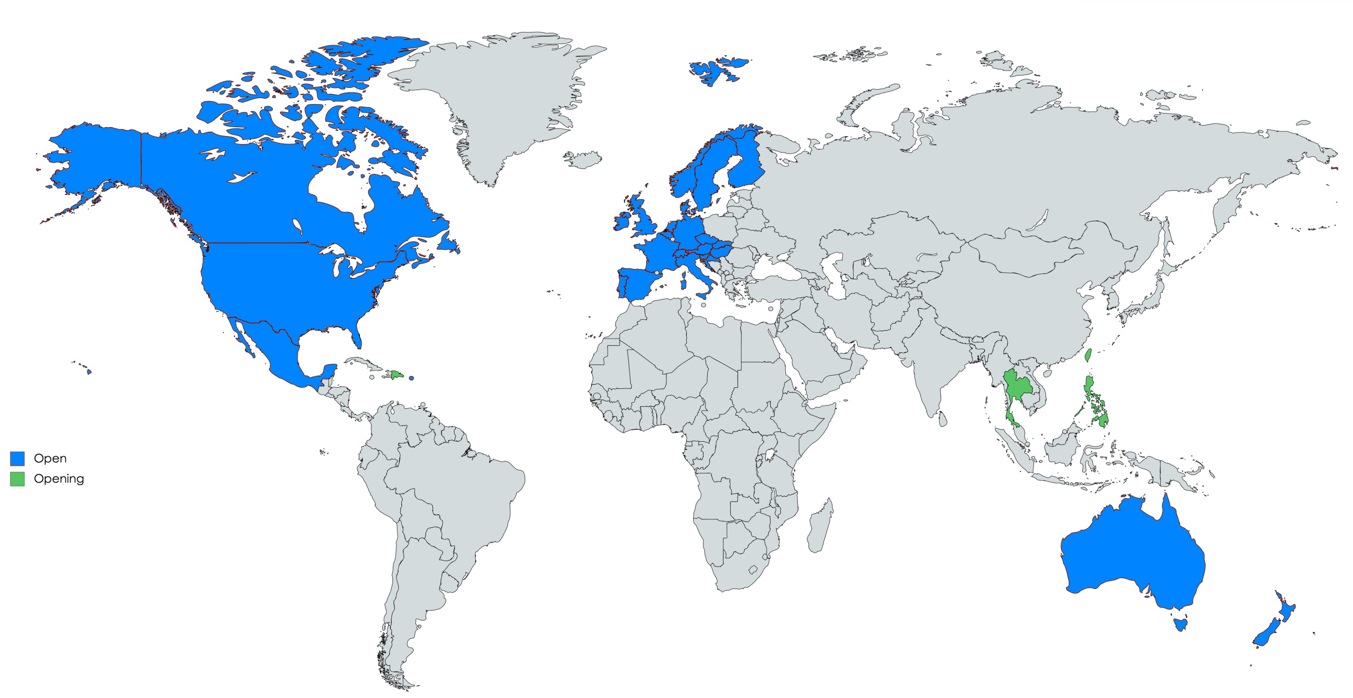
Product Distribution 運輸與配送
Global Shipping and Distribution Centers 個配送中心
Notes:
ASEA then ships the product to distribution centers all around the world, which in turn ship to over 30 countries where ASEA is open.
(July 2018)

Slide 24
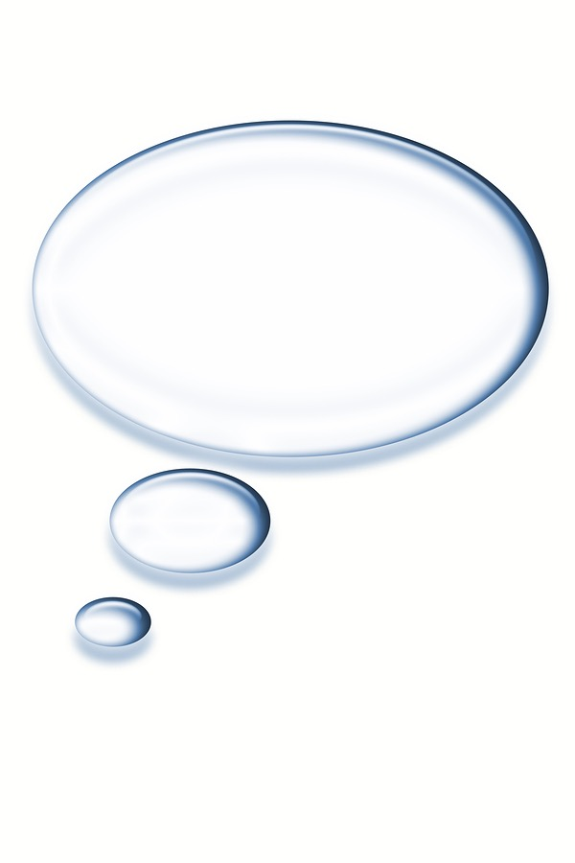
Information vs
Mis-information?
Notes:
Positive information on ASEA abounds on the internet. BUT keep in mind that Google is a search engine and not a research engine. Some people “google” ASEA and see a website that claims ASEA is just expensive salt water.
This particular blog article written in 2012 doesn’t mention the studies that ASEA had done at that time, and still doesn’t acknowledge many other clinical studies on ASEA. The false claim that ASEA is just salt water is made by one non-practicing physician who retired 27 years ago and is now a paid blogger.
The site also bashes other things that could be considered “natural alternatives to pharmaceuticals” - like chiropractic care, naturopathy, acupuncture, and even vitamins.

Slide 25
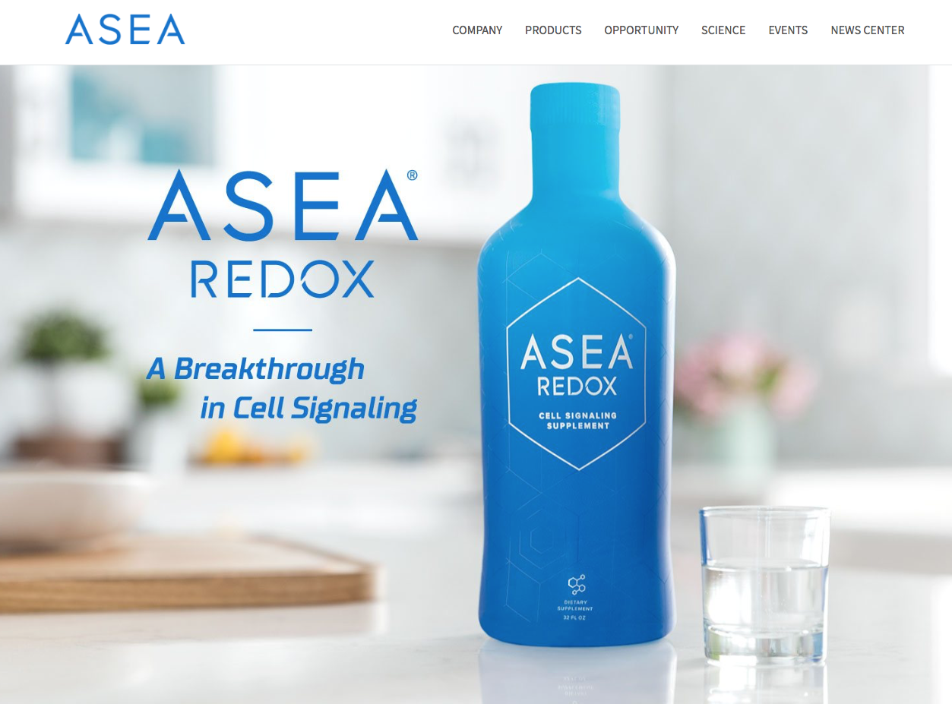
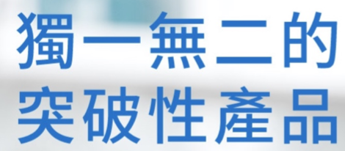
www.ASEAGlobal.com
Notes:
You can find a summary of these and other scientific validation at ​AseaGlobal.com​, the official ASEA Corporate website.

Slide 26
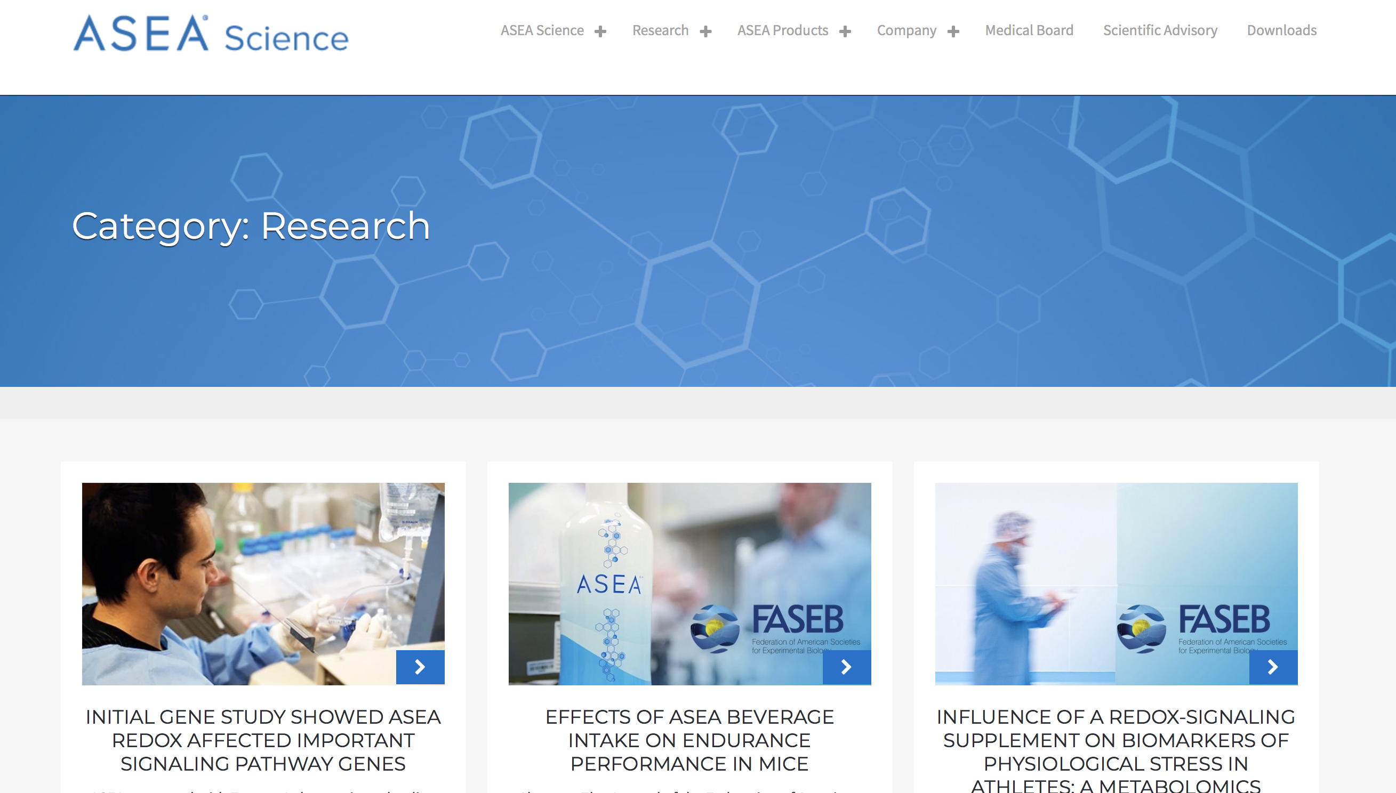
www.ASEAScience.com
Notes:
You can find a summary of these and other scientific validation at ​AseaGlobal.com​, the official ASEA Corporate website.

Slide 27
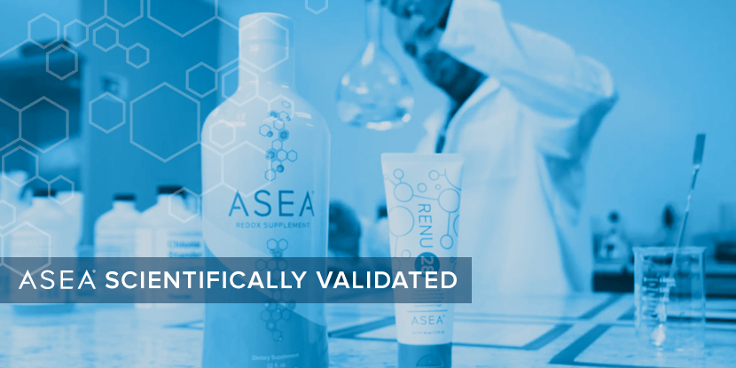
Notes:
BioAgilytix Laboratories performs bio-analysis for 21 of the top 25 global pharmaceutical and biotech companies.
This company routinely verifies the presence of stabilized, bio-active Redox Signaling Molecules in ASEA’s Redox products.

Slide 28
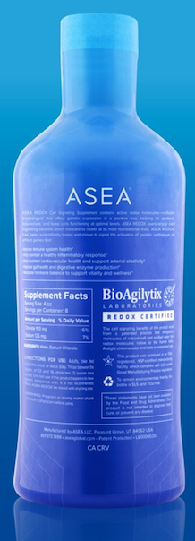
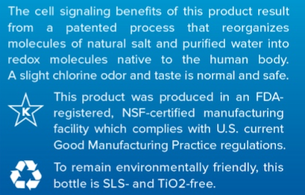
Notes:
Every bottle of ASEA and every tube of ASEA Redox Gel is labelled with the BioAgilitix “Redox Certified” seal
Do you think that reputable companies like Tauret Labs and BioAgilitix would allow their name to be used if ASEA was “just expensive salt and water”?

Slide 29
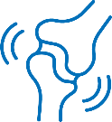
ASEA Regulates Healthy Gene Expression
安司雅規範了健康基因的表達
In an 8 week study ASEA REDOX was shown to activate gene signaling pathways
that positively impact
5 major areas of health 經八星期的研究 顯示安司雅氧化還原活化了基因信號, 成功地影響了保健的五個重要領域
Hormone
Modulation
調整荷爾蒙
Immune System
Healthy
Digestion
保障消化系統
Inflammatory Response
發炎反應
Cardiovascular Health 健全心血管系統
ASEA REDOX is not a treatment or cure for any disease or medical condition
Notes:
- Taueret Laboratories is one of the most sophisticated ​genetic​ testing labs in North America.
In a recent human trial, Taueret Labs found that ASEA Redox Supplement activated FIVE important gene signaling pathways that impact FIVE major areas of your health. Did you know that genetic pathways can become inactive? In 8 weeks, ASEA consumption caused ​up to 31%​ greater, positive activation of pathways that:
1. Improve immune system health
2. Help maintain a healthy inflammatory response
3. Help maintain cardiovascular health and support arterial elasticity
4. Improve digestive health
5. Modulate hormonal balance
This helps explain why ASEA users are reporting such a huge variety of system-wide improvements!

Slide 30
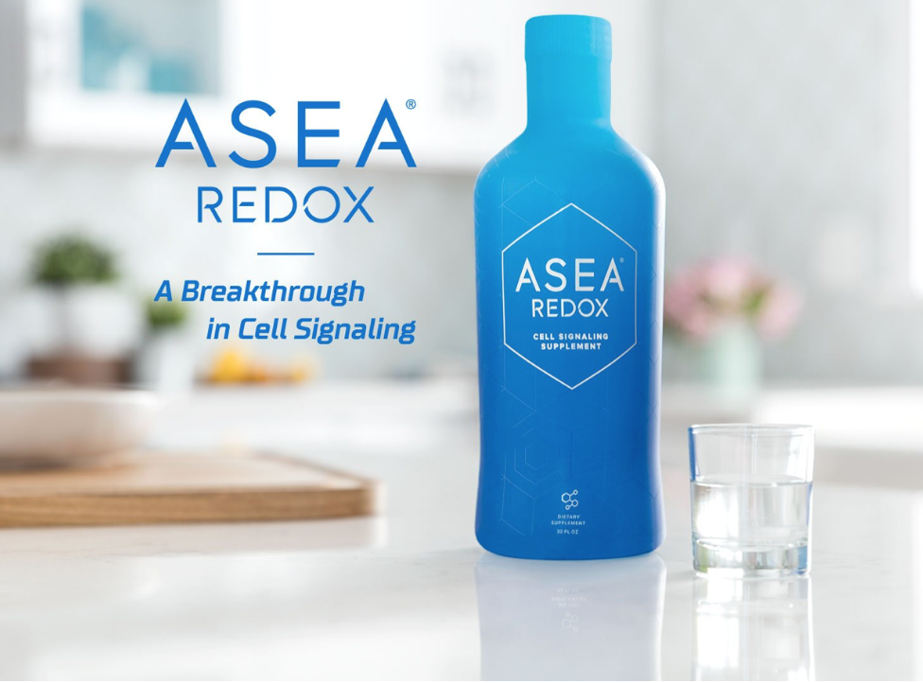
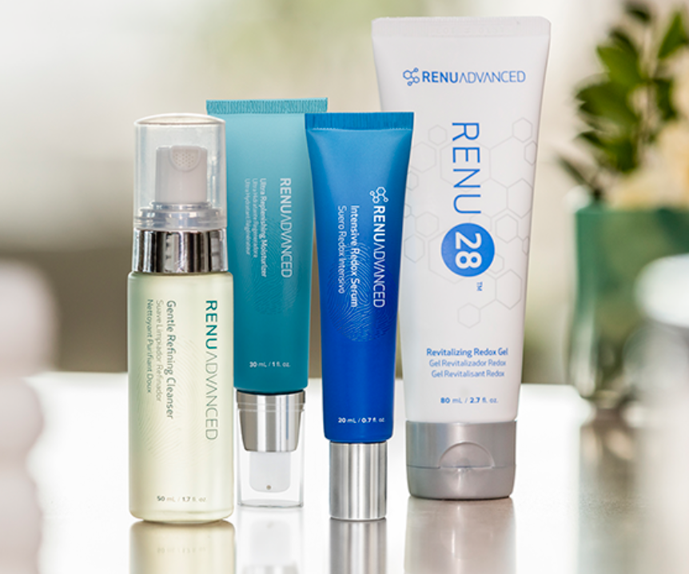
Complete Cellular Health
RENU Advanced Skin Care
GET YOUR BEST SKIN BACK
Notes:
ASEA helps to empower your 75 trillion cells to rejuvenate themselves - so that your body can function more like it did when you were younger.
ASEA enhances athletic performance and endurance without any “banned substances”. Extensive safety studies have proven ASEA Redox Supplement is 100% safe.

Slide 31
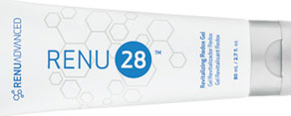
Redox Gel
氧化還原凝膠
ASEA REDOX
Flagship Cellular Health
Technology
Notes:
Let’s start with RENU 28, ASEA’s revitalizing whole-body skin gel, since results are so visible.

Slide 32
Feeling is Believing 感覺就是相信
Experience Redox Molecules 體驗氧化還原分子
“3 in 5” 5分鐘3次
Identify an area of the body where there is discomfort, soreness, stress, tightness, or limited range of motion
找出身體不適，酸痛，壓力，緊繃或動不了的地方
Rate it on a scale of 1-10 (10 is bad)
以1~10的方式來評估它 (10是不好的）
Apply Redox Gel 3 times in 5 minutes
塗上凝膠. 5分鐘3次
Rate discomfort, soreness, stress, tightness or limited range of motion again on a scale of 1-10
請評價您剛才的酸痛
Notice what happens!
感覺有什麼不同嗎？
Notes:
RENU 28 is far more than an anti-wrinkle gel. Redox Molecules support the body to remove “bad stuff”, “wakes up” cells and empowers them to work more efficiently.
{ACTION SLIDE: guide guests at your meeting to experience Redox Molecules by using the “3 in 5” method from Dr David Silverman. Ask guests to identify an area of the body where there is discomfort, soreness, stress, tightness, or limited range of motion
Ask them to rate it on a scale of 1-10 (10 being the worst) Apply Redox Gel 3 times in 5 minutes.
Rate the discomfort, soreness, stress, tightness or limited range of motion again on a scale of 1-10. They can apply a 4th or 5th time if necessary.}

Slide 33
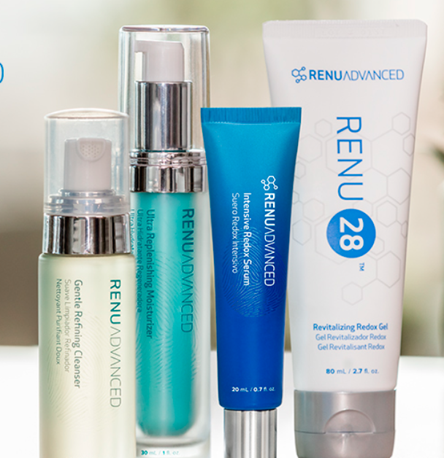
RENU ADVANCED
The first and only REDOX
Anti-aging face care system
HEALTH &
BEAUTY
Complementary
Cellular Health
Technologies
Gentle Refining Cleanser
Immediate Benefits
Helps tone and balance skin
Supports healthy cell renewal
Gently cleanses and removes makeup
Ultra Replenishing Moisturizer
Four-Week Benefits
Increased skin moisture by 43%
Intensive REDOX Serum
30-Minute Benefits
Visibly more radiant skin
Ease appearance of fine lines, wrinkles, and puffiness
Use on the body for discomfort
Notes:
Building on the success of RENU 28, ASEA launched a skin care line called RENU Advanced. It’s the world’s FIRST and ONLY Redox Signaling-based, anti-aging skin care system. It’s designed for both women and men - of all ages and skin types.
1. A Gentle Refining Cleanser that tones and hydrates while washing away impurities.
2. RENU 28 Gel for face, neck and anywhere we want to repair.
3. Intensive Redox Serum, which is even more concentrated than RENU 28. Applied to trouble areas, results can often be seen within 30 minutes. Great for targeting around the eyes or mouth.
4. Ultra-Replenishing Moisturizer, with premium ingredients that include a topical probiotic and oxygen attractors that increase the oxygen content of our skin. Why is this important? By age 40, the oxygen content of skin is typically depleted by 50%! Clinical trials show that this high end product leaves skin 43% more hydrated within 4 weeks.
In an 8 week, 3rd-party clinical trial, this RENU Advanced Skin Care system caused a reduction in “​photo-aging”​ in ​92%​ of participants. Photo-aging is the damage done to skin from sun exposure over a person's lifetime!

Slide 34
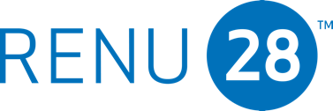
ASEA REDOX
The most advanced whole body skin technology ever brought to market.
Simple
Proven
Affordable
Effective
Flagship Cellular Health
Technology
Notes:
Let’s begin by learning about ASEA’s Redox Gel, called RENU 28. RENU28 has helped tens of thousands of people to achieve cellular health from the Outside In:
It’s simple & pure.
It’s proven safe & hypoallergenic.
It’s affordable & very multi-purpose.
It is effective - for improving skin health & also for relief of aches & discomfort.

Slide 35
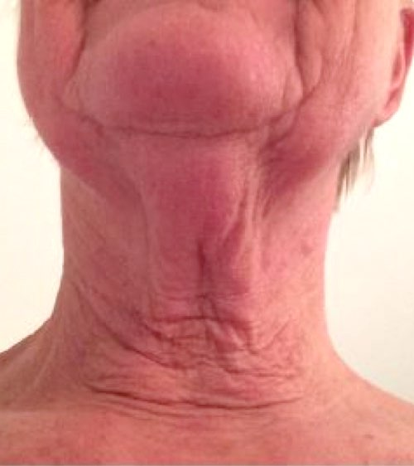
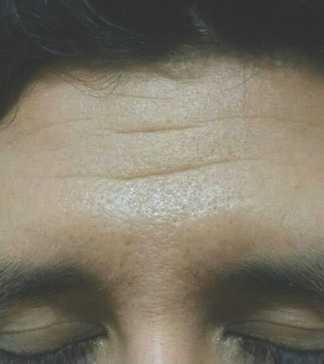
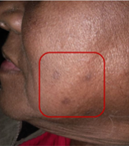
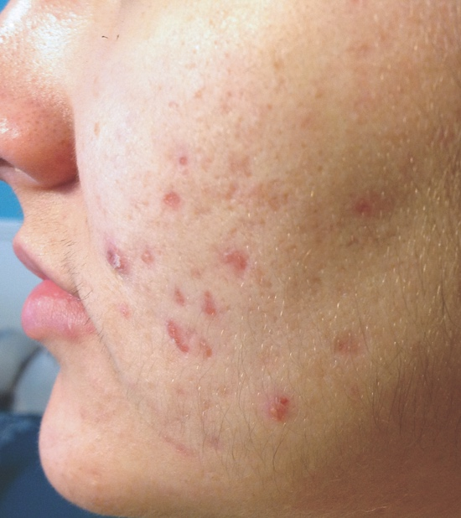
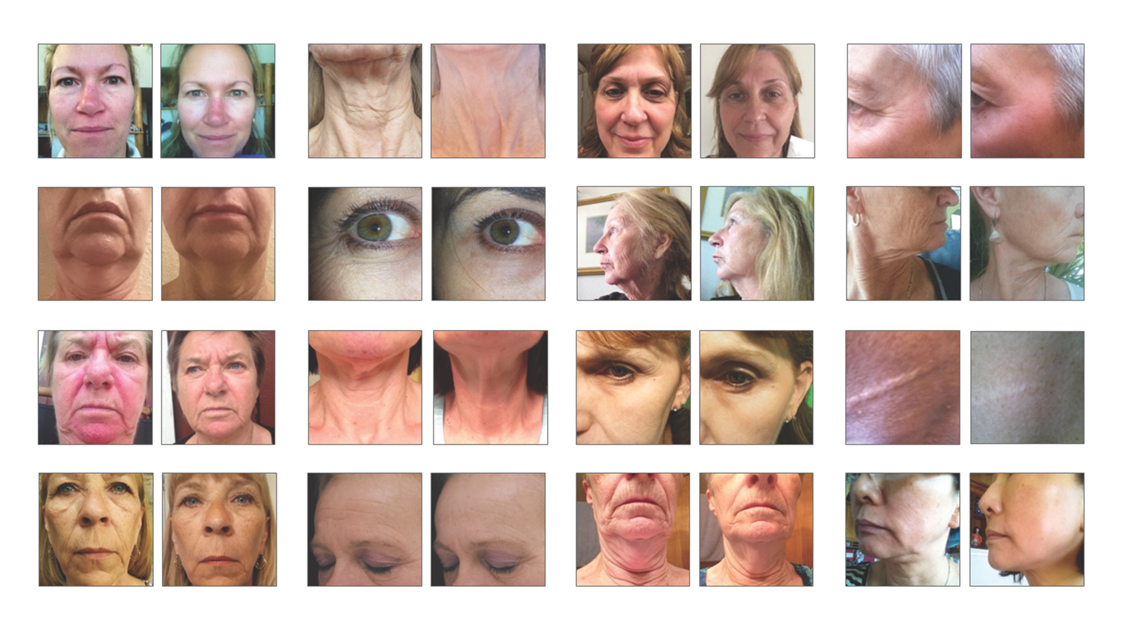
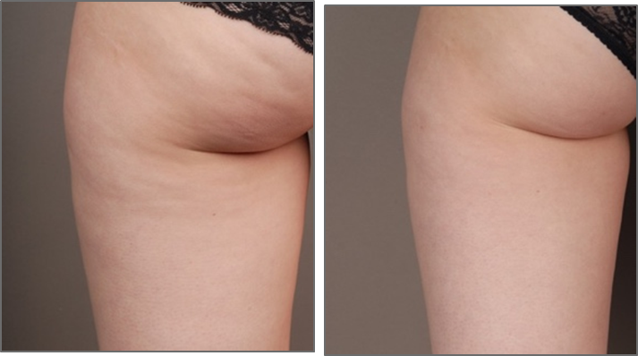
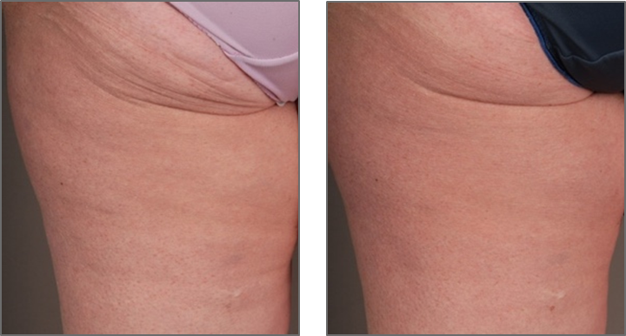
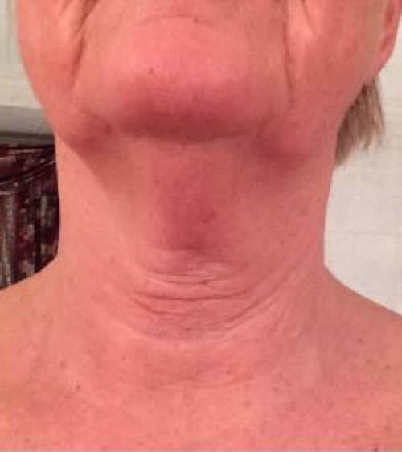
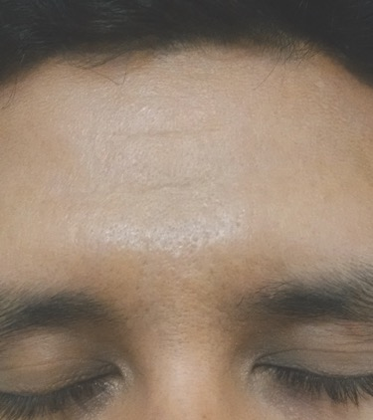
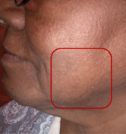
SKIN CHALLENGES 皮膚問題
ASEA REDOX
Flagship Cellular Health
Technology
Notes:
Here are a number of ​user-submitted ​before-and-after pictures showing results these people received using RENU 28, the Redox gel.

Slide 36
DISCOMFORT RELIEF 緩解不適
ASEA REDOX
Flagship Cellular Health
Technology
Notes:
This picture demonstrates the power of Redox Molecules to create healthier cells. These are one woman’s 28 day results with RENU 28.
Redox Molecules send signals that tell our body to eliminate unwanted or dangerous cells. Neighboring healthy cells then divide and take their place, resulting in healthier tissue.
Isn’t this what we want to happen to the tissues on the ​inside​ as well as the ​outside​ of our body?

Slide 37
Changing Lives Worldwide
Global Testimonials
改善全人類的生活
Notes:
Thousands of testimonials have been received from people experiencing profound benefits from our products. (Testimonials can be accessed at live meetings, websites, Facebook sites, conference calls, webinars)
Some people notice positive changes very quickly.
For others, in can take several months.
But studies have proven: ​everyone​ can benefit from ASEA’s products.

Slide 38
ASEA products are not intended to treat, cure, or prevent any disease or medical condition.
ASEA 及 Renu28 不用於診斷，治療，治癒，或預防任何疾病及就醫狀況。
Notes:
ASEA makes no medical claims to prevent, treat, or cure any disease or medical condition. In the United States, only a substance classified as a pharmaceutical drug can makes those claims. ASEA is not classified as a drug, but as a dietary supplement.
Give it a chance to safely and naturally support your body’s ​own​ innate ability to be healthy, or to heal itself, with ZERO side-effects.
ASEA is ​more​ available, ​more​ quickly, to ​more​ people, for a much ​broader​ range of health concerns - than it would be if it had become a DRUG.

Slide 39
The Right Time to Engage in the ASEA Opportunity
Established company yet new
正處穩定爆發期的嶄新公司
34 markets and expanding
全球34個市場，且持續擴張中
Growth is accelerating
加速成長中
DSN Top 100 Company
榮獲全球百大直銷公司美譽
Notes:
ASEA is now ranked in the top 100 of all NWM companies worldwide , based on cumulative revenue. This incredible success validates the effectiveness of our products and our business model.
Passing the 5 year mark means ASEA is out of the “risk zone”, but it is still pre-momentum!
ASEA’s objective is to become a long term legacy company.

Slide 40
Earn “Thank You” checks
by changing
lives around
the globe
掙取“感謝”支票
改變世界各地
人們的生活
Notes:
Do you see how powerful and unique this technology is? No one in the world except ASEA produces Redox Signaling Molecules outside of the body.How would you like to earn “Thank you” checks by changing people’s lives? who have you thought of that can benefit from Redox Signaling Molecules?

Slide 41
“There is nothing better than making a living while making a difference.”
“沒有什麼較之謀生時影響世界更勝一籌了。”
Notes:
“There is nothing better than making a living while making a difference”.
ASEA offers this opportunity to people who share our vision.

Slide 42
Powerful & Unique Compensation
強而有力且獨特的獎金制度
Something for Everyone 適合所有人
8 Ways to Get Paid 8種得到收入的方法
Fair & Generous 公平豐厚
Pays Weekly 週結週領
IMMEDIATE INCOME TO PART TIME
FULL TIME TO UNLIMITED INCOME
Notes:
Although we are not going to get into a lot of detail on the ASEA compensation plan in this presentation, it’s important to note, that its fair and generous, it pays weekly and there are 8 ways to earn income in ASEA, all the way from part time, to full time, to big time income.

Slide 43
Notes:
Although we are not going to get into a lot of detail on the ASEA compensation plan in this presentation, it’s important to note, that its fair and generous, it pays weekly and there are 8 ways to earn income in ASEA, all the way from part time, to full time, to big time income.

Slide 44
ASEA 2018
Average Income (USD)
平均收入（美元）
Notes:
Here, you can get an idea of what an ASEA income means for many people.

Slide 45
ASEA Corporate Executives 公司高層主管
Experience + Integrity

Slide 46
E²PC ASEA Culture’s Formula for Success
ASEA文化的成功秘訣
Ego
Economics
自我
經濟
Motivation for
Commitment to
Principles
原則
Capacity
能力

Slide 47
ASEA Today
Stands on very firm foundation
Post Start-Up - Early Momentum Company
50% Growth each of the past 2 years - DSA Top 75 in the World & Climbing
Open in 33 Countries
Financially Sound - Profitable with No Long Term Debt
Solid, Disciplined Executive Leadership Team - Been together 7 plus years
Own the REDOX Platform with broadening unique product portfolio & story
All Scalable Systems On-Line and Optimized
Production Facility can scale to 4X Current Revenue with little additional capital
Steady and committed field leadership across all markets
Most unique and substantive culture of authenticity and humanity in the industry

Slide 48
ASEA
Proven and Established
In just the last 3 years:
58% growth
7 additional countries opened - 31 total
1.4 Million cases of ASEA have been sent since 2015
1.3 Million tubes of RENU 28 have been sent since 2015
80% increase in average weekly commission dollars paid

Slide 49
THINK

Slide 50
ASEA Strategy 2019 and Onward
Focus on creating new tools, videos, apps to support existing markets
Focus on expanding “Tier 1” markets:

Slide 51
WHERE DO YOU SEE YOURSELF? 你在哪裡呢？
1
2
3
Customer
使用者
Part-time sharing
兼職分享者
Business builder 事業經營者
Notes:
Some people would simply like to use our products and become “ASEA Customers”. They purchase at full retail price or receive discounted “Preferred Customer” pricing if they choose monthly shipments.
Every day, all year long, and for as long as they use ASEA, their body will continue to have extra support for health and immunity. Aging and cell damage from the assaults of modern living will have less effect on them.
Those who become “ASEA Associates” ​always​ get best wholesale pricing. Associates also qualify to receive the most ​free product​.
When you become an Associate, you are set up with everything you need to earn “thank you checks” from ASEA if and when you begin to engage in an ASEA business.
It costs $40 to become an Associate. Associates then receive a free personal ASEA website and online business center that is customized for them and fully automated.

Slide 52
Stress Environment & Ecosystem
Mega Trends
Aging Population
Exploding World Population
Declining Health
Increasing Sovereign Debt
Healthcare Cost Increasing

Slide 53
Purchase directly from the person who introduced you to ASEA
直接向您的ASEA介紹人購買產品
Products sold from
non-ASEA online sites can be fraudulent orders purchased with stolen credit cards.
Do you want to support this type of criminal activity? Of course not!
不要在網路上亂買產品，那可能是騙人的。有人可能會偷紀錄您的信用卡資訊。您想支持這樣的犯罪行為嗎？當然不要！
4 Reasons to support your dedicated ASEA Associate
支持您的ASEA介紹人: 4個理由
They took time to educate and inform you of this life changing technology
他們花時間教育及介紹能改變生命的科技
Build up Loyalty Rewards with ASEA, which means FREE product
可以累積忠誠顧客點數，代表很多免費的產品
Warranty is not valid for sales from non-ASEA buying sites
在非官方認可的網站上購買沒有產品保險及質量保障
Notes:
Sign up or purchase directly from the person who is responsible for your choosing to join ASEA. They have an approved, legitimate ASEA business and have taken the time to reach out to you.
Never order ASEA online from a non-branded ASEA website. The product is not guaranteed to be authentic, may be fraudulent or beyond the expiration date. Some people are illegally selling product purchased with stolen credit cards - criminal activity we would never want to support.
Joining correctly means you have the option to earn Loyalty Reward Points with ASEA, redeemable for FREE products. It also means you will have support and guidance when you need it.

Slide 54
Malaysia Packs (not all)
Notes:
Some people would simply like to use our products and become “ASEA Customers”. They purchase at full retail price or receive discounted “Preferred Customer” pricing if they choose monthly shipments.
Every day, all year long, and for as long as they use ASEA, their body will continue to have extra support for health and immunity. Aging and cell damage from the assaults of modern living will have less effect on them.
Those who become “ASEA Associates” ​always​ get best wholesale pricing. Associates also qualify to receive the most ​free product​.
When you become an Associate, you are set up with everything you need to earn “thank you checks” from ASEA if and when you begin to engage in an ASEA business.
It costs $40 to become an Associate. Associates then receive a free personal ASEA website and online business center that is customized for them and fully automated.

Slide 55
Malaysia
Entrepreneur Pack
Notes:
Some people would simply like to use our products and become “ASEA Customers”. They purchase at full retail price or receive discounted “Preferred Customer” pricing if they choose monthly shipments.
Every day, all year long, and for as long as they use ASEA, their body will continue to have extra support for health and immunity. Aging and cell damage from the assaults of modern living will have less effect on them.
Those who become “ASEA Associates” ​always​ get best wholesale pricing. Associates also qualify to receive the most ​free product​.
When you become an Associate, you are set up with everything you need to earn “thank you checks” from ASEA if and when you begin to engage in an ASEA business.
It costs $40 to become an Associate. Associates then receive a free personal ASEA website and online business center that is customized for them and fully automated.

Slide 56
“
The best way to predict the future is to create it.
最好預測未來的方法就是去創造它
”
Peter Drucker

Slide 57
ASEA
is changing the world
one cell at a time
ASEA
將一步一步的改變世界
Notes:
Maybe you have a health problem or ​know​ someone with a health problem.
Maybe you like the idea of improving your chances for maintaining good health as you age.
Maybe you like ​athletics​ or sports - and would love to go farther and faster. Or do you just want to have less fatigue, more energy and stamina in your daily life?
You may be attracted to the idea of having fewer wrinkles! Healthier, younger-looking skin!
You might like the idea of having extra income! And building residual income for retirement - with an ASEA business.
You may find fulfillment in joining others of like mind, serving so many who need help.

Slide 58
You Can Change Your Life
with
ASEA
你可以與ASEA
一同改變你的生活
Notes:
What type of interest do YOU have?
With ASEA, you have the potential to change your life for the better in so many ways! And if you choose to tell others, you can be instrumental in changing the lives of thousands.
Thank you for your time...

